Slide 1

Notes:
Cover slide for the FinzData Weekly issue dated September 5, 2026. The deck covers liquidity, capital flows and positioning for the week.

Slide 2
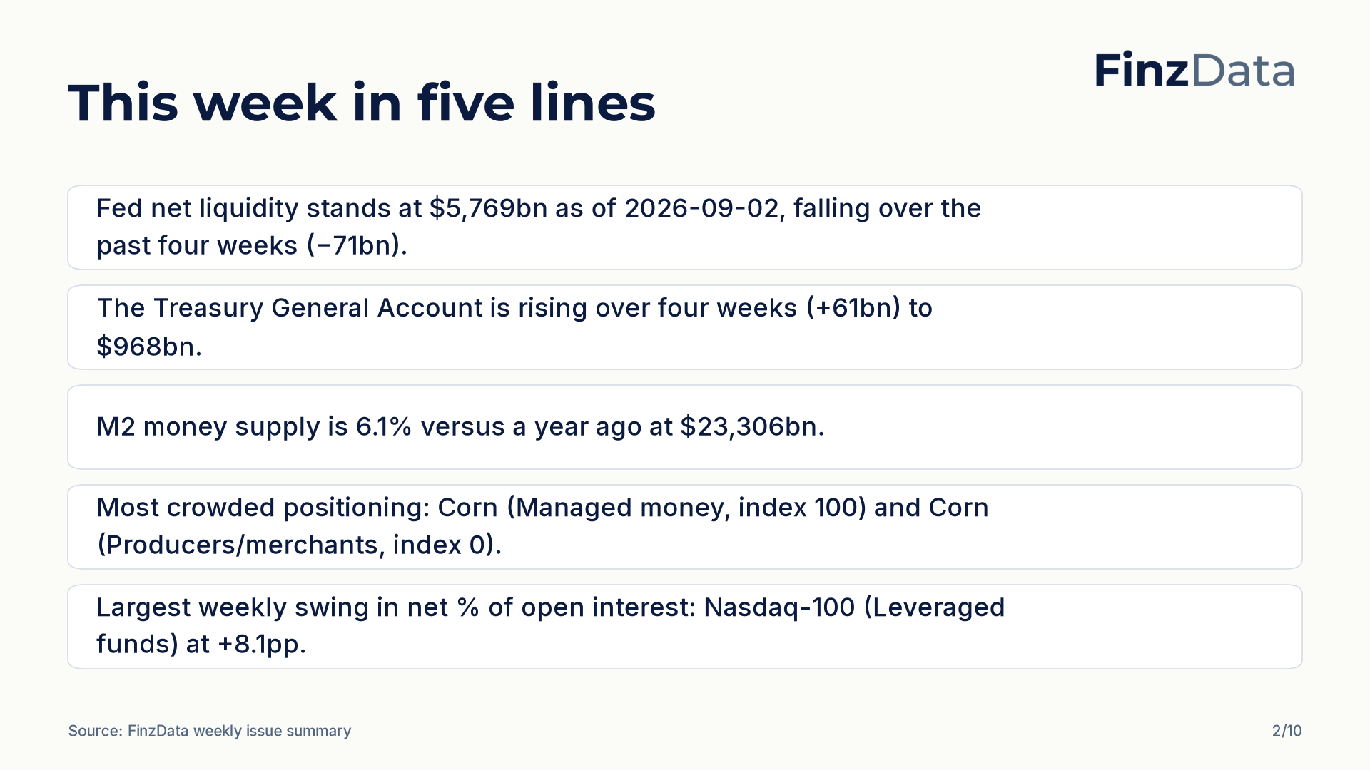
Notes:
Key takeaways from this week's issue: Fed net liquidity stands at $5,769bn as of 2026-09-02, falling over the past four weeks (−71bn). The Treasury General Account is rising over four weeks (+61bn) to $968bn.

Slide 3
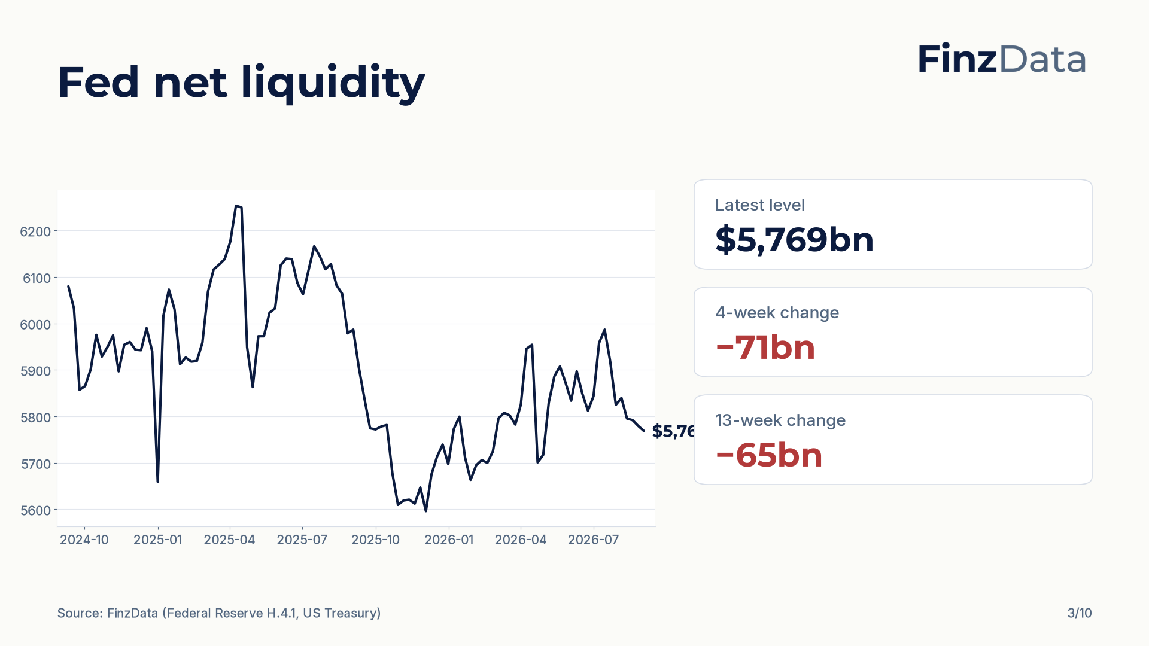
Notes:
Fed net liquidity stands at $5,769bn as of 2026-09-02. The four-week change is −71bn and the thirteen-week change is −65bn.

Slide 4
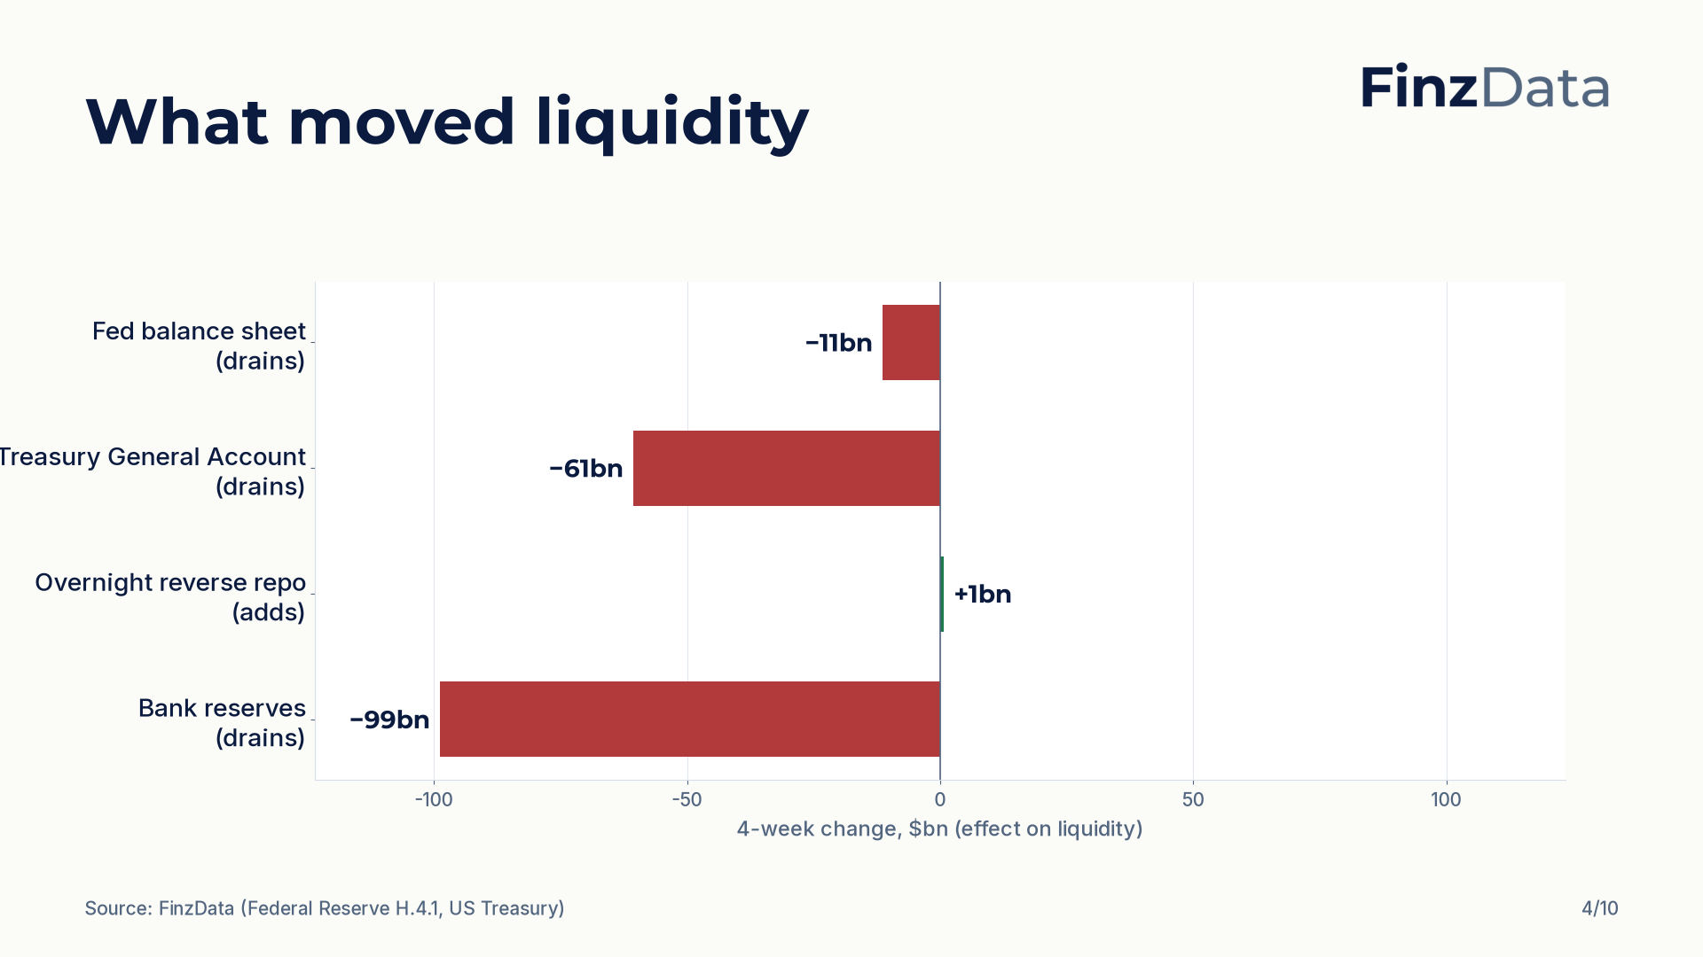
Notes:
Four-week changes in the components of net liquidity: Fed balance sheet −11bn; Treasury General Account −61bn; Overnight reverse repo +1bn; Bank reserves −99bn.

Slide 5
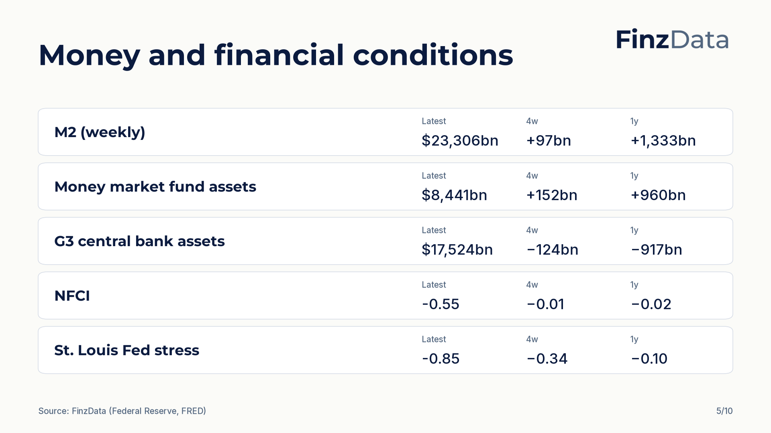
Notes:
Money and financial conditions snapshot. For example, M2 (weekly) stands at $23,306bn as of 2026-08-31.

Slide 6
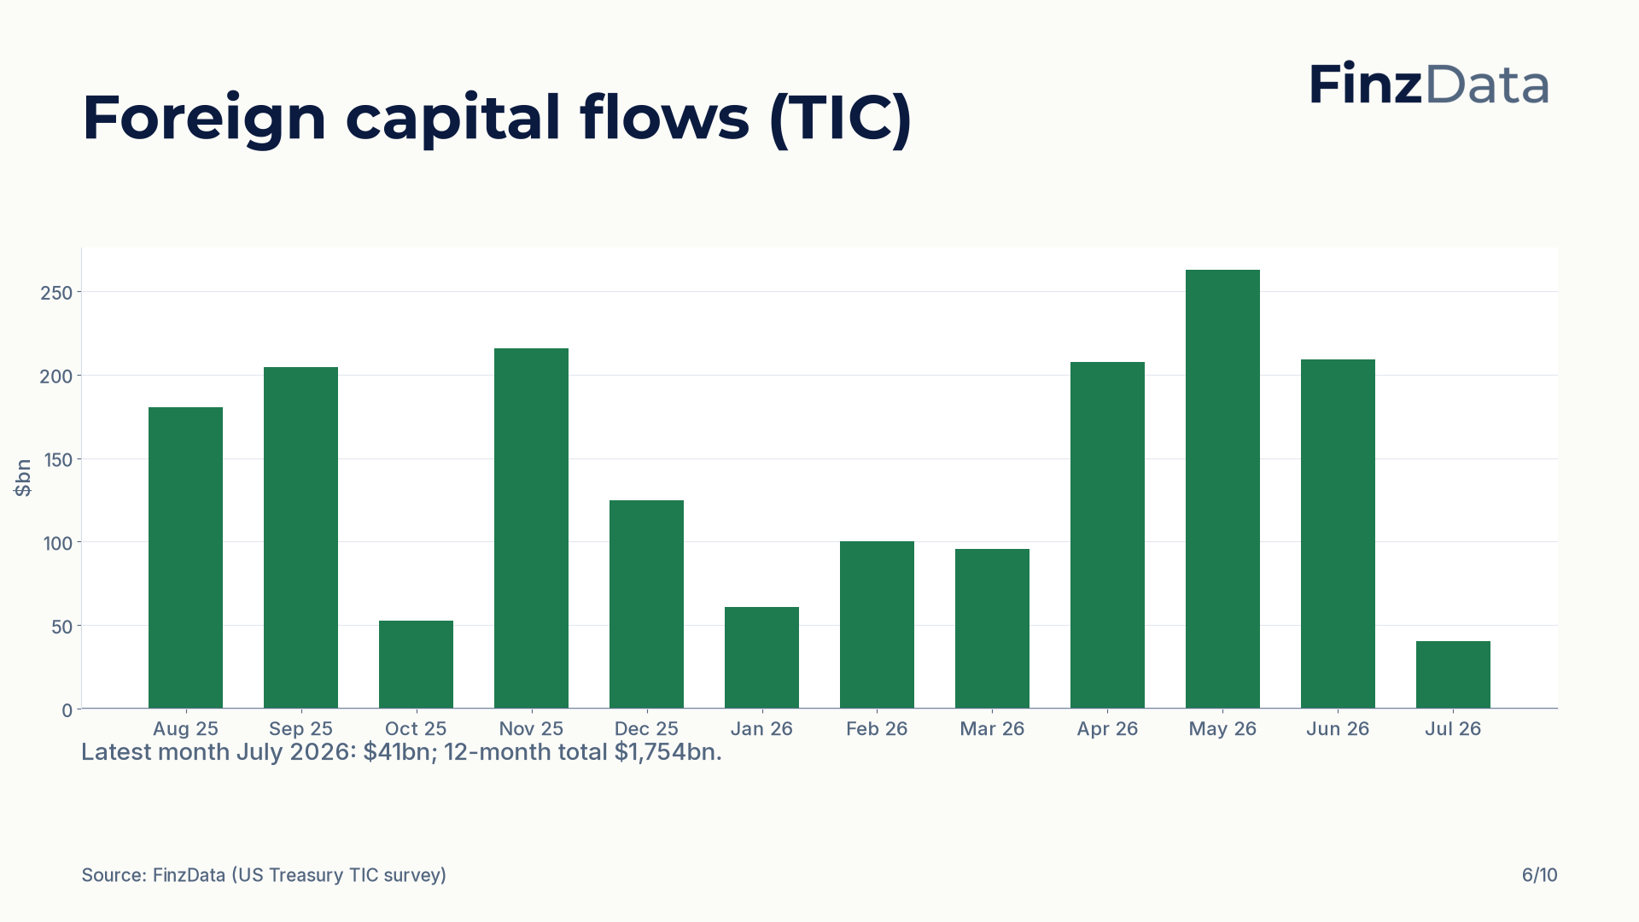
Notes:
Net foreign purchases of US long-term securities over the last 12 months. Latest month July 2026: $41bn; 12-month total $1,754bn.

Slide 7
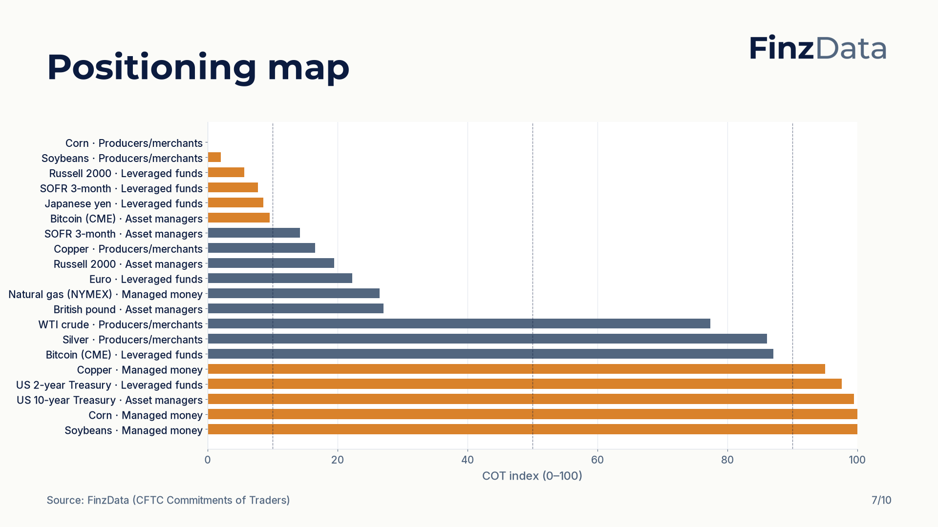
Notes:
COT index for every tracked market and trader group. Highest reading: Corn (Managed money) at 100; lowest: Corn (Producers/merchants) at 0.

Slide 8
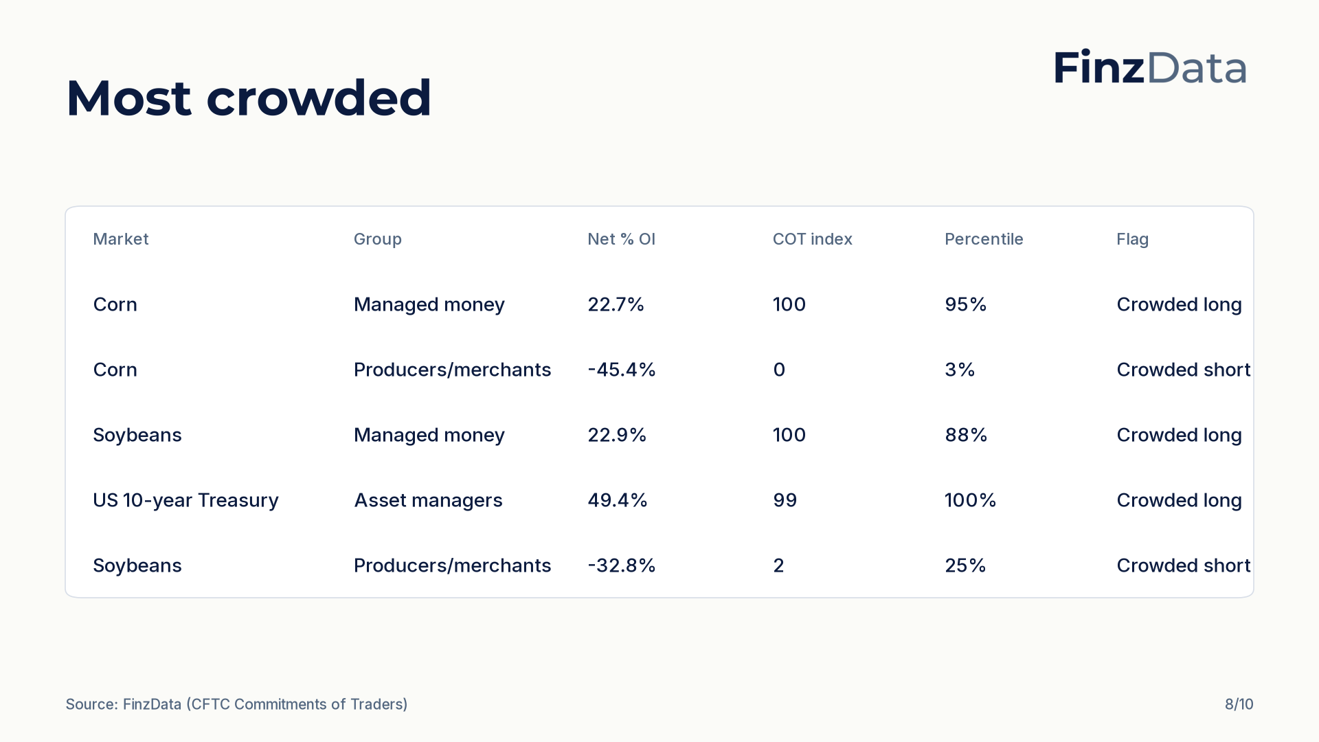
Notes:
Most crowded positioning by distance of the COT index from 50. Top of the list: Corn (Managed money) with a COT index of 100 and net 22.7% of open interest.

Slide 9
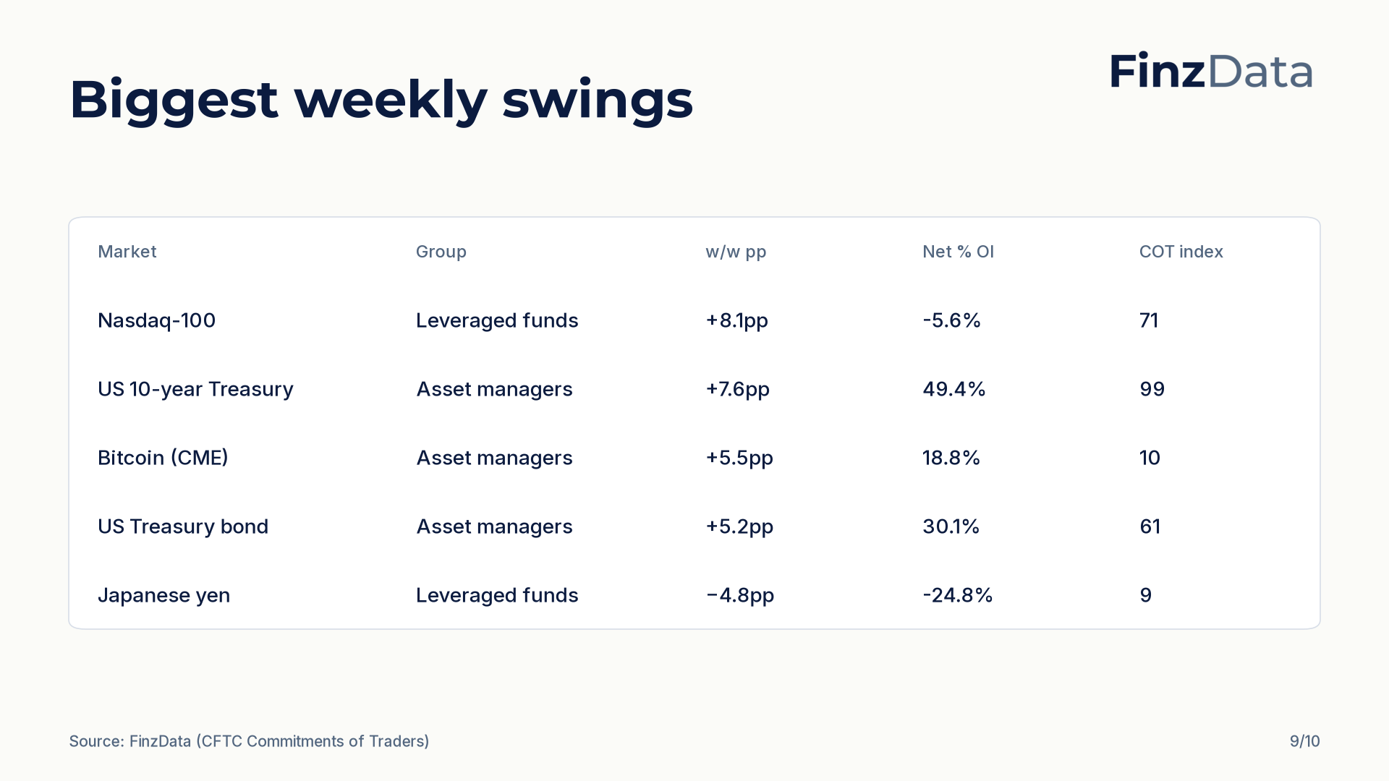
Notes:
Largest weekly swings in net percent of open interest. Biggest move: Nasdaq-100 (Leveraged funds) at +8.1pp to -5.6% of open interest.

Slide 10

Notes:
Closing slide. Every figure in this deck is available through the FinzData API; the full report is at finzdata.com/research/weekly/2026-09-05.

