Slide 1

Notes:
Cover slide for the FinzData Weekly issue dated September 12, 2026. The deck covers liquidity, capital flows and positioning for the week.

Slide 2
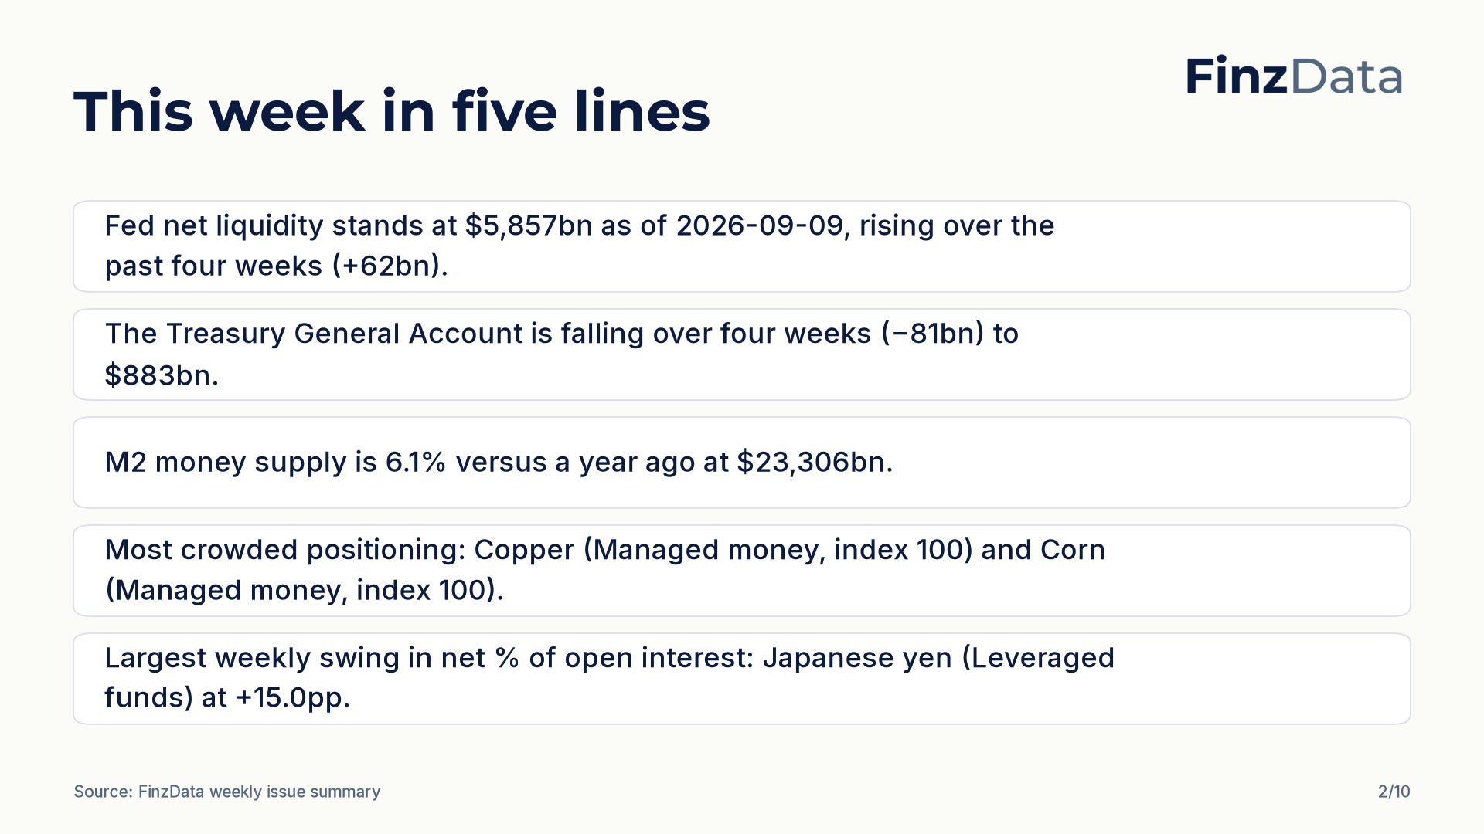
Notes:
Key takeaways from this week's issue: Fed net liquidity stands at $5,857bn as of 2026-09-09, rising over the past four weeks (+62bn). The Treasury General Account is falling over four weeks (−81bn) to $883bn.

Slide 3
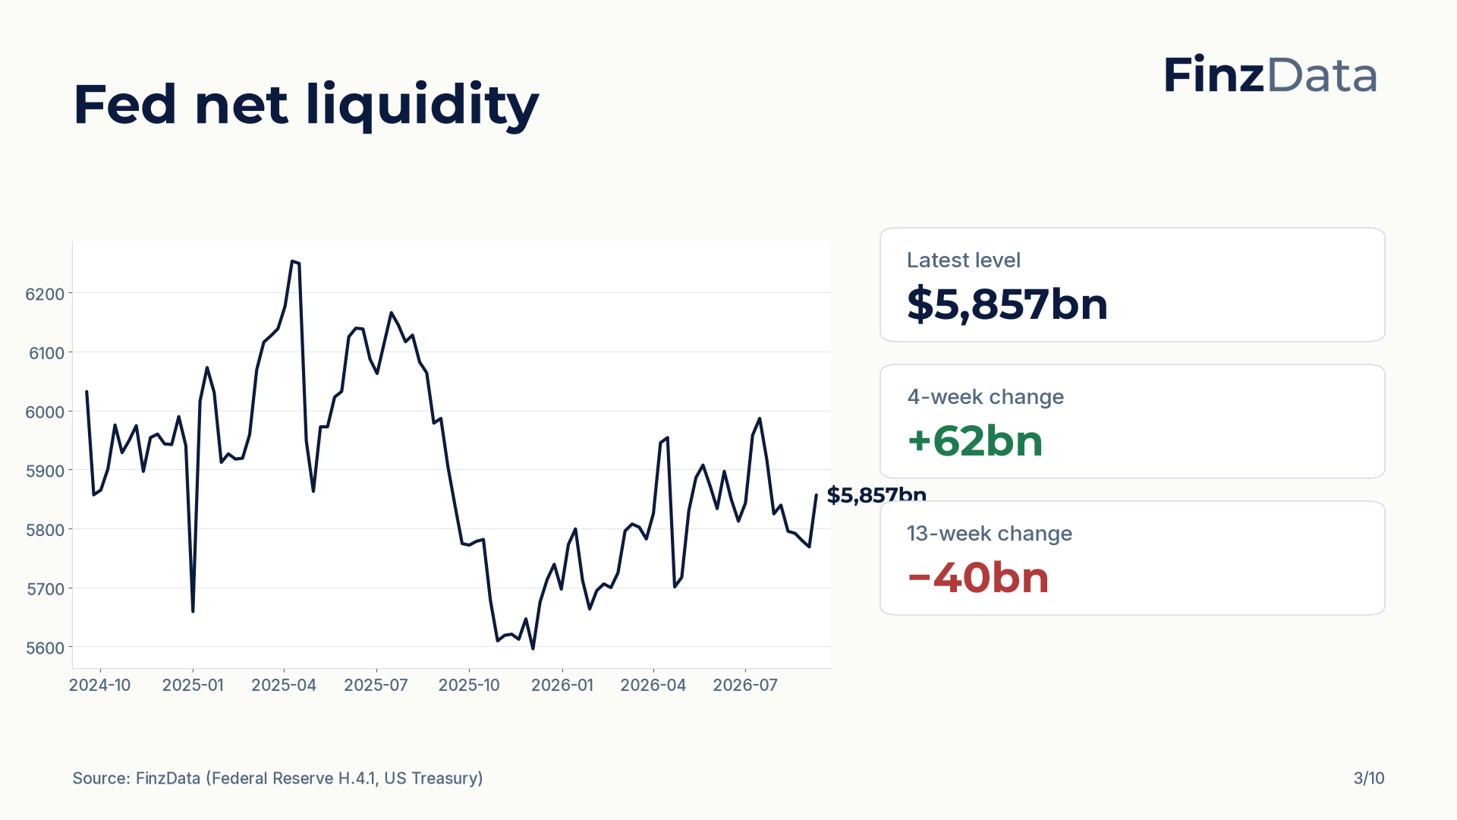
Notes:
Fed net liquidity stands at $5,857bn as of 2026-09-09. The four-week change is +62bn and the thirteen-week change is −40bn.

Slide 4
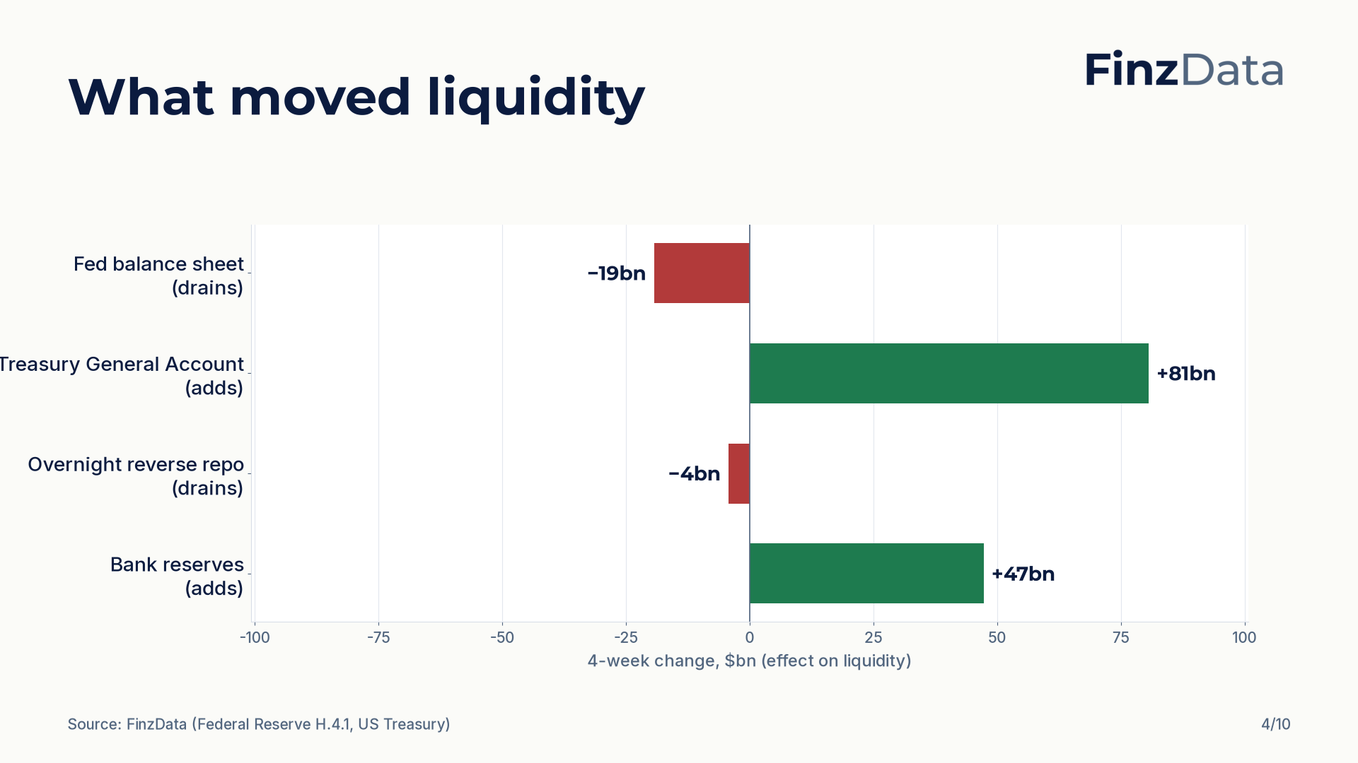
Notes:
Four-week changes in the components of net liquidity: Fed balance sheet −19bn; Treasury General Account +81bn; Overnight reverse repo −4bn; Bank reserves +47bn.

Slide 5
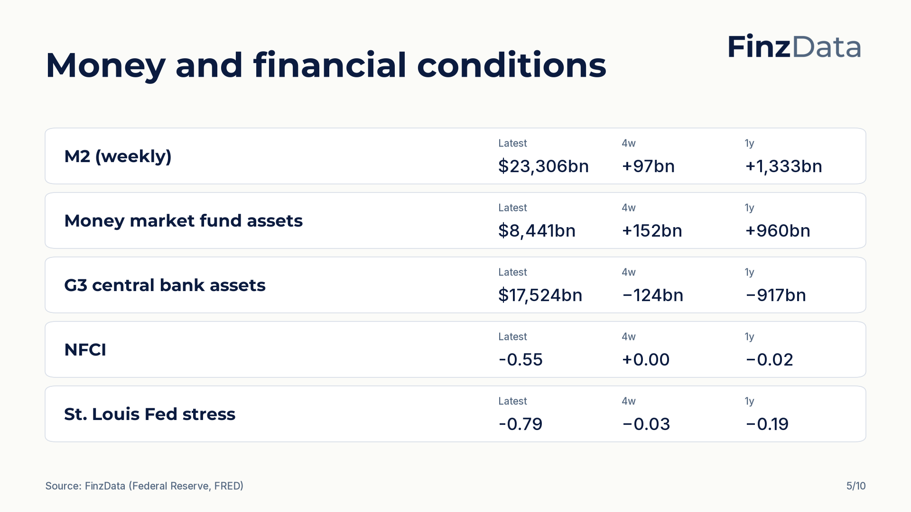
Notes:
Money and financial conditions snapshot. For example, M2 (weekly) stands at $23,306bn as of 2026-08-31.

Slide 6
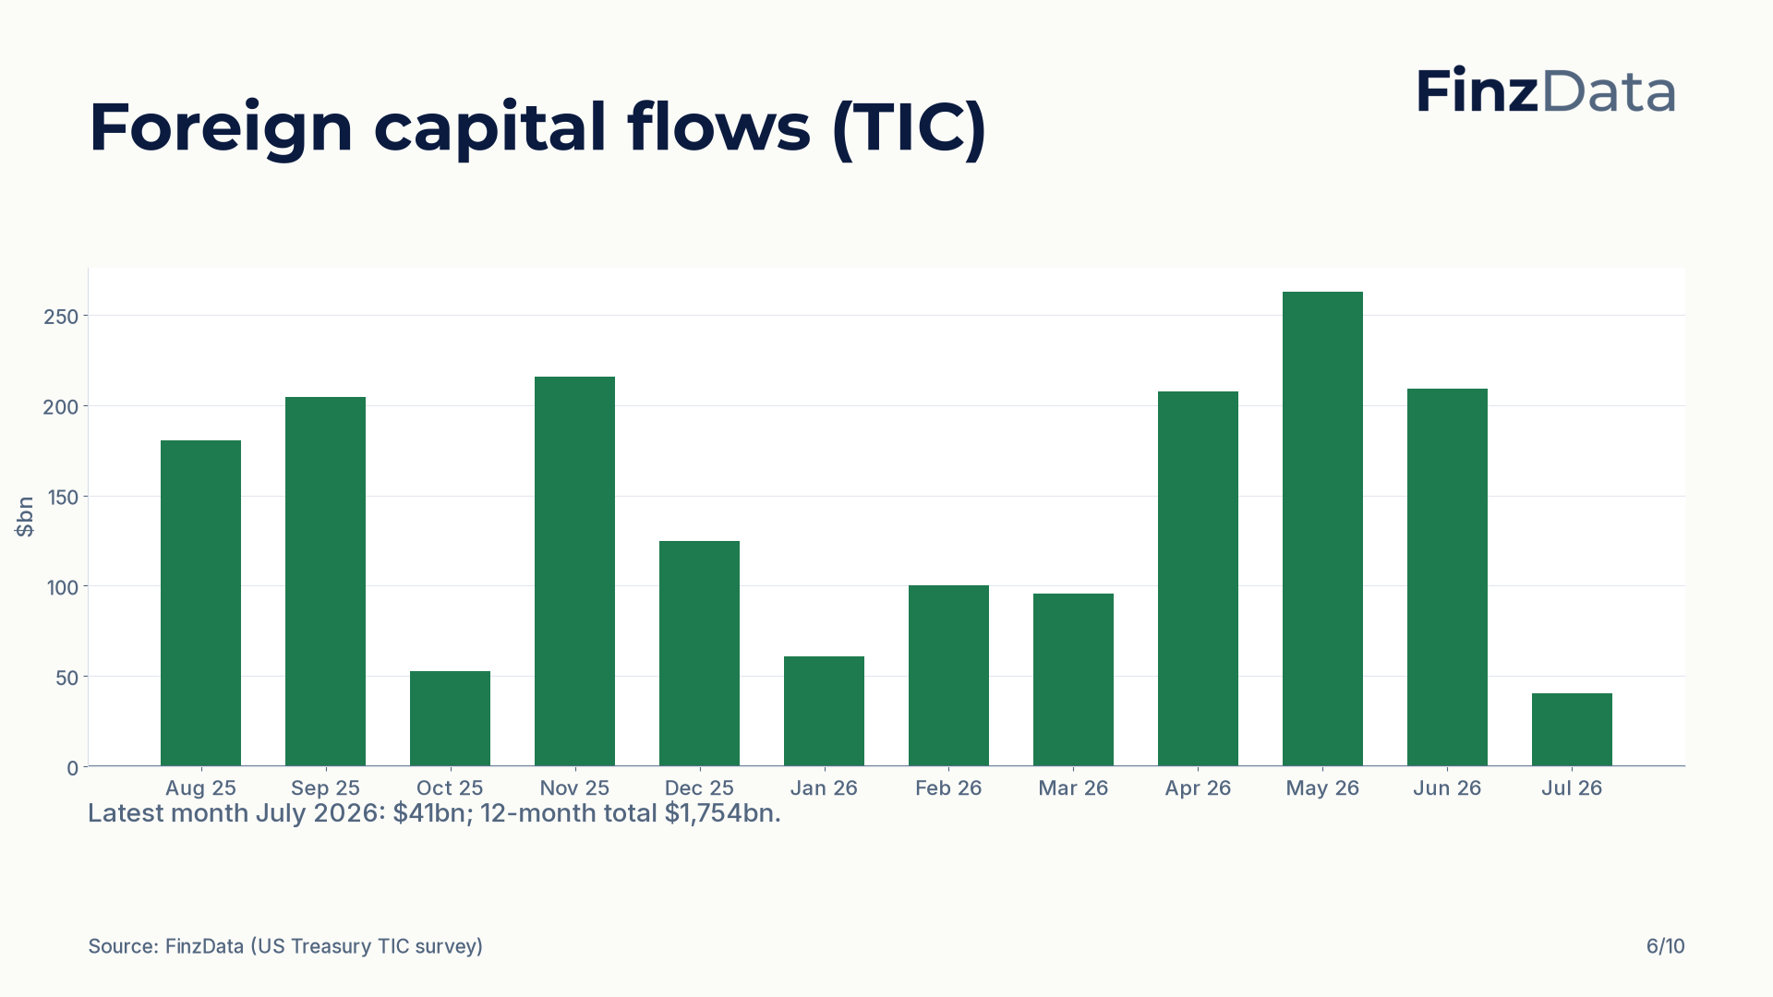
Notes:
Net foreign purchases of US long-term securities over the last 12 months. Latest month July 2026: $41bn; 12-month total $1,754bn.

Slide 7
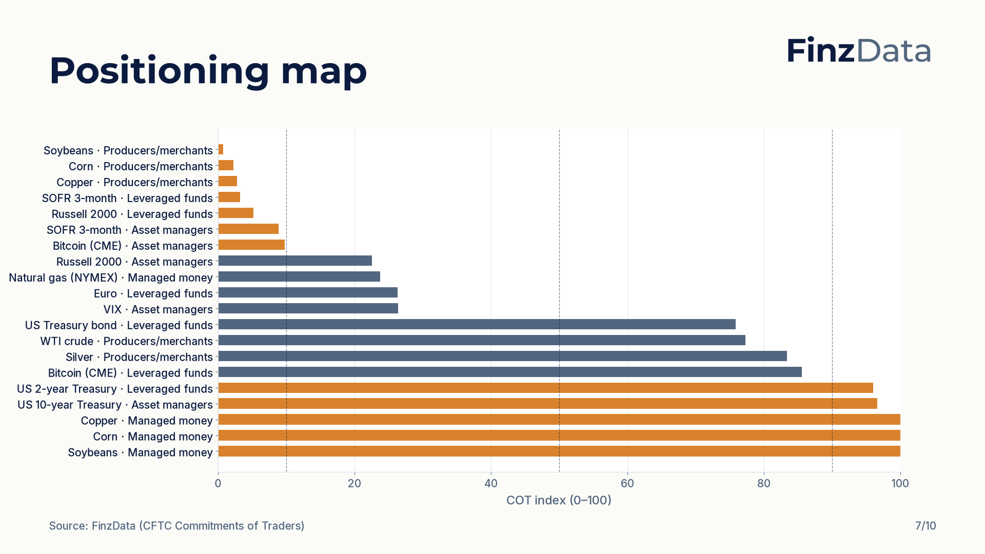
Notes:
COT index for every tracked market and trader group. Highest reading: Copper (Managed money) at 100; lowest: Soybeans (Producers/merchants) at 1.

Slide 8
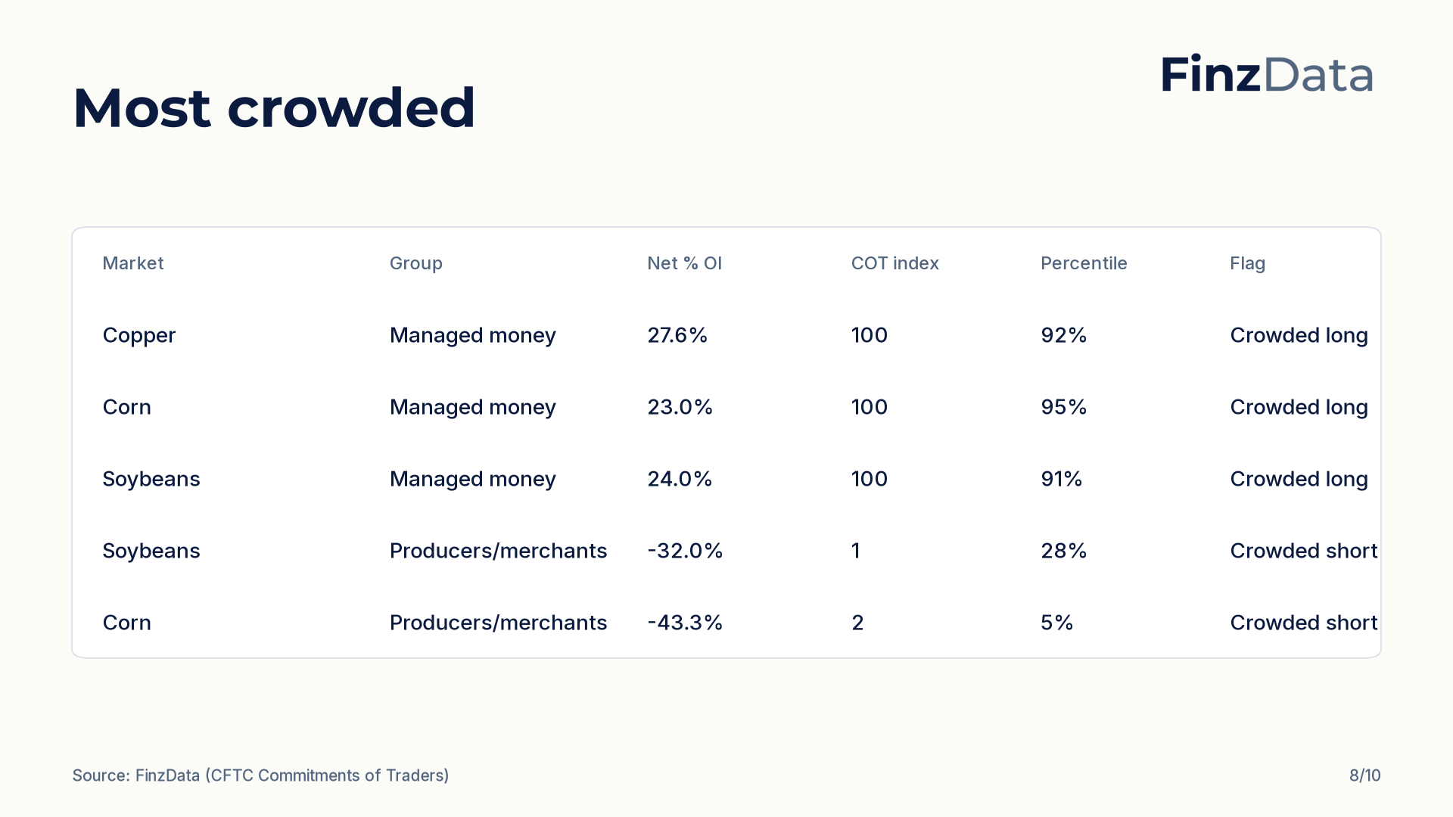
Notes:
Most crowded positioning by distance of the COT index from 50. Top of the list: Copper (Managed money) with a COT index of 100 and net 27.6% of open interest.

Slide 9
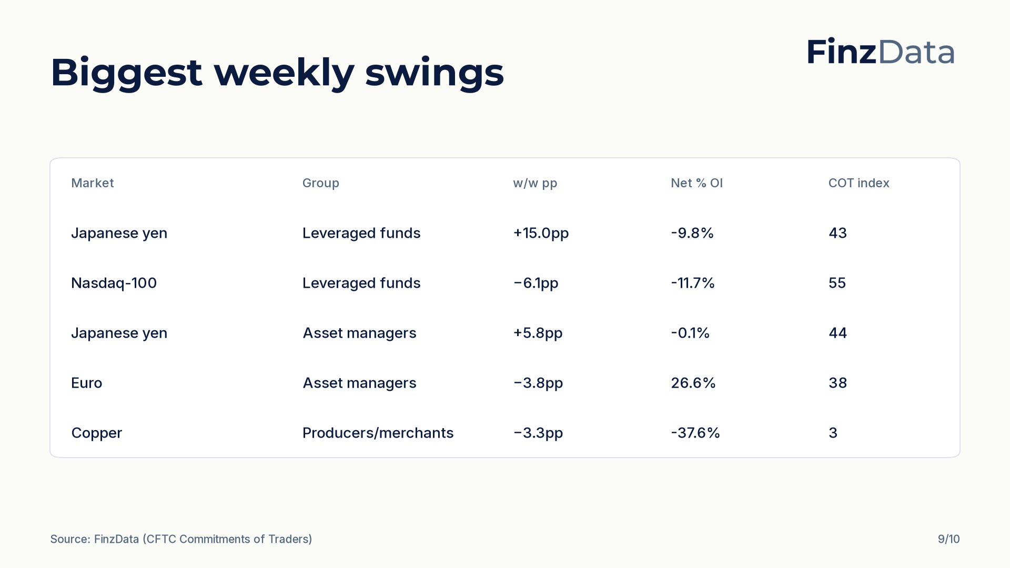
Notes:
Largest weekly swings in net percent of open interest. Biggest move: Japanese yen (Leveraged funds) at +15.0pp to -9.8% of open interest.

Slide 10

Notes:
Closing slide. Every figure in this deck is available through the FinzData API; the full report is at finzdata.com/research/weekly/2026-09-12.

