Slide 1

Notes:
Cover slide for the FinzData Weekly issue dated September 26, 2026. The deck covers liquidity, capital flows and positioning for the week.

Slide 2
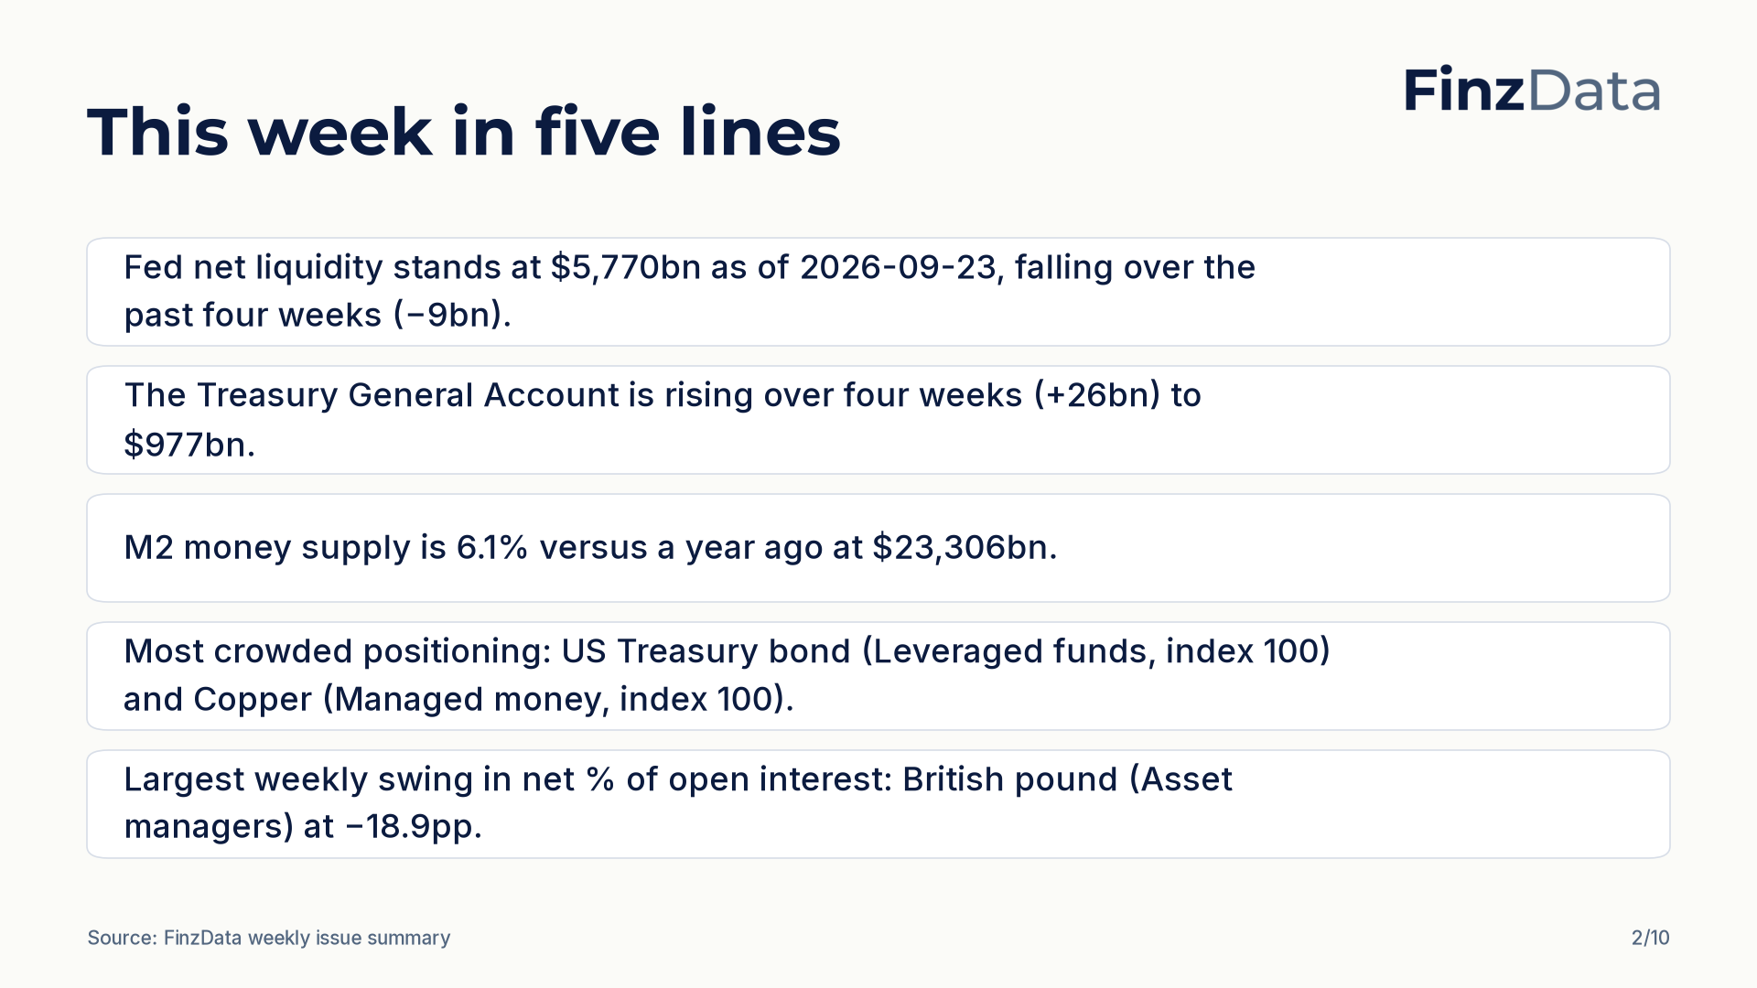
Notes:
Key takeaways from this week's issue: Fed net liquidity stands at $5,770bn as of 2026-09-23, falling over the past four weeks (−9bn). The Treasury General Account is rising over four weeks (+26bn) to $977bn.

Slide 3
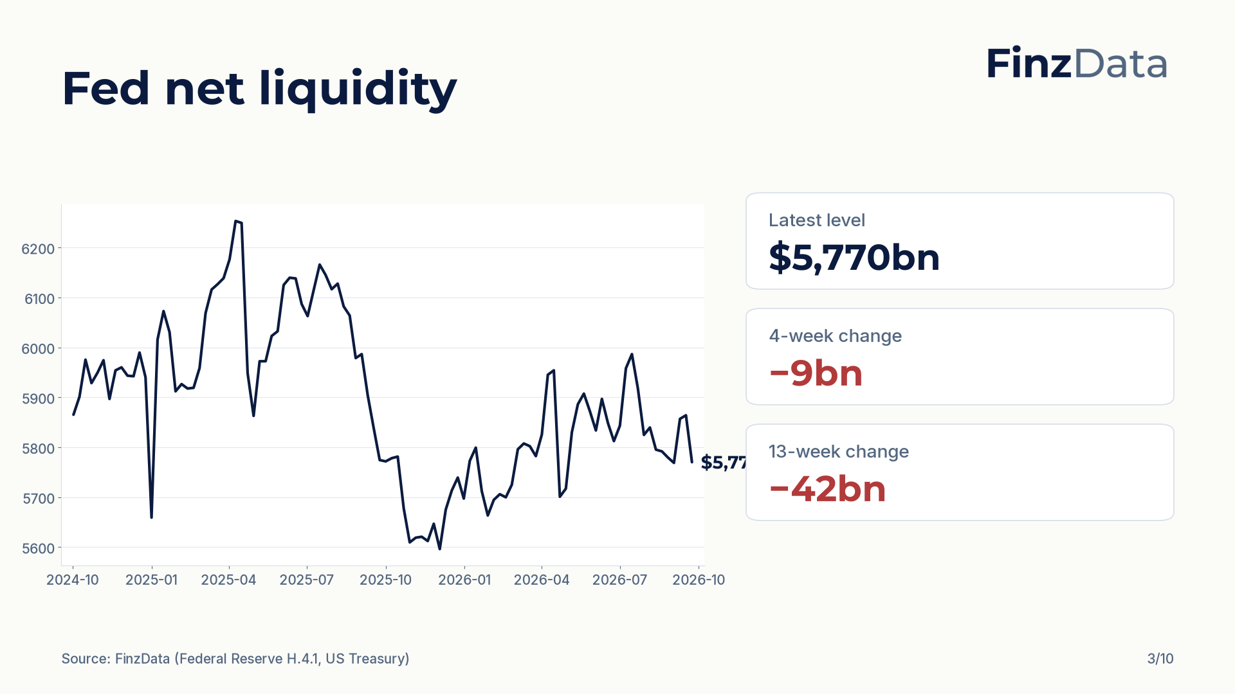
Notes:
Fed net liquidity stands at $5,770bn as of 2026-09-23. The four-week change is −9bn and the thirteen-week change is −42bn.

Slide 4
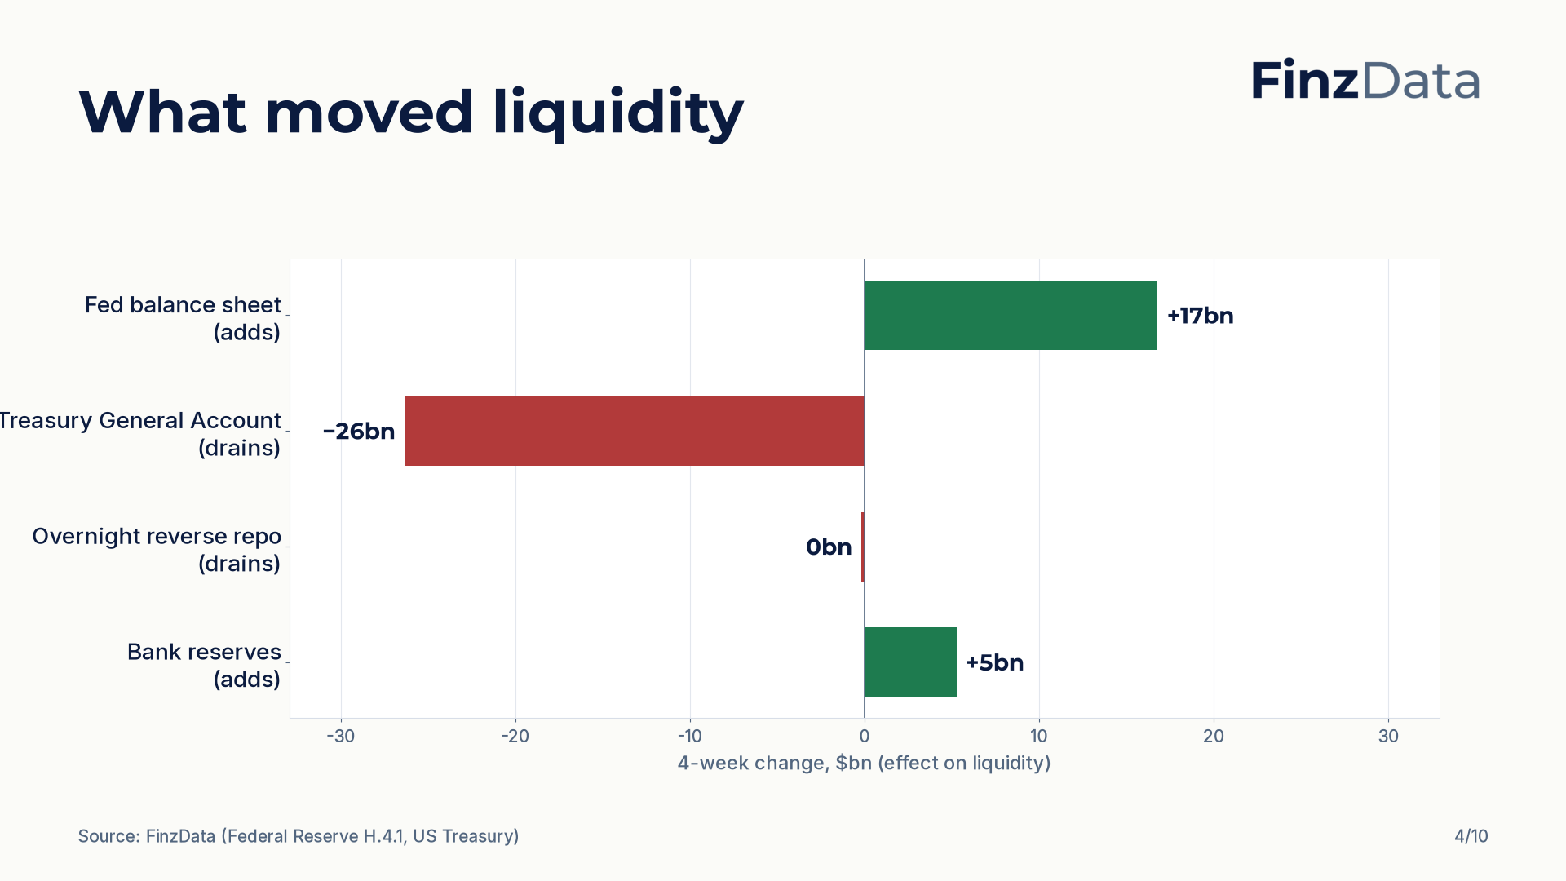
Notes:
Four-week changes in the components of net liquidity: Fed balance sheet +17bn; Treasury General Account −26bn; Overnight reverse repo 0bn; Bank reserves +5bn.

Slide 5
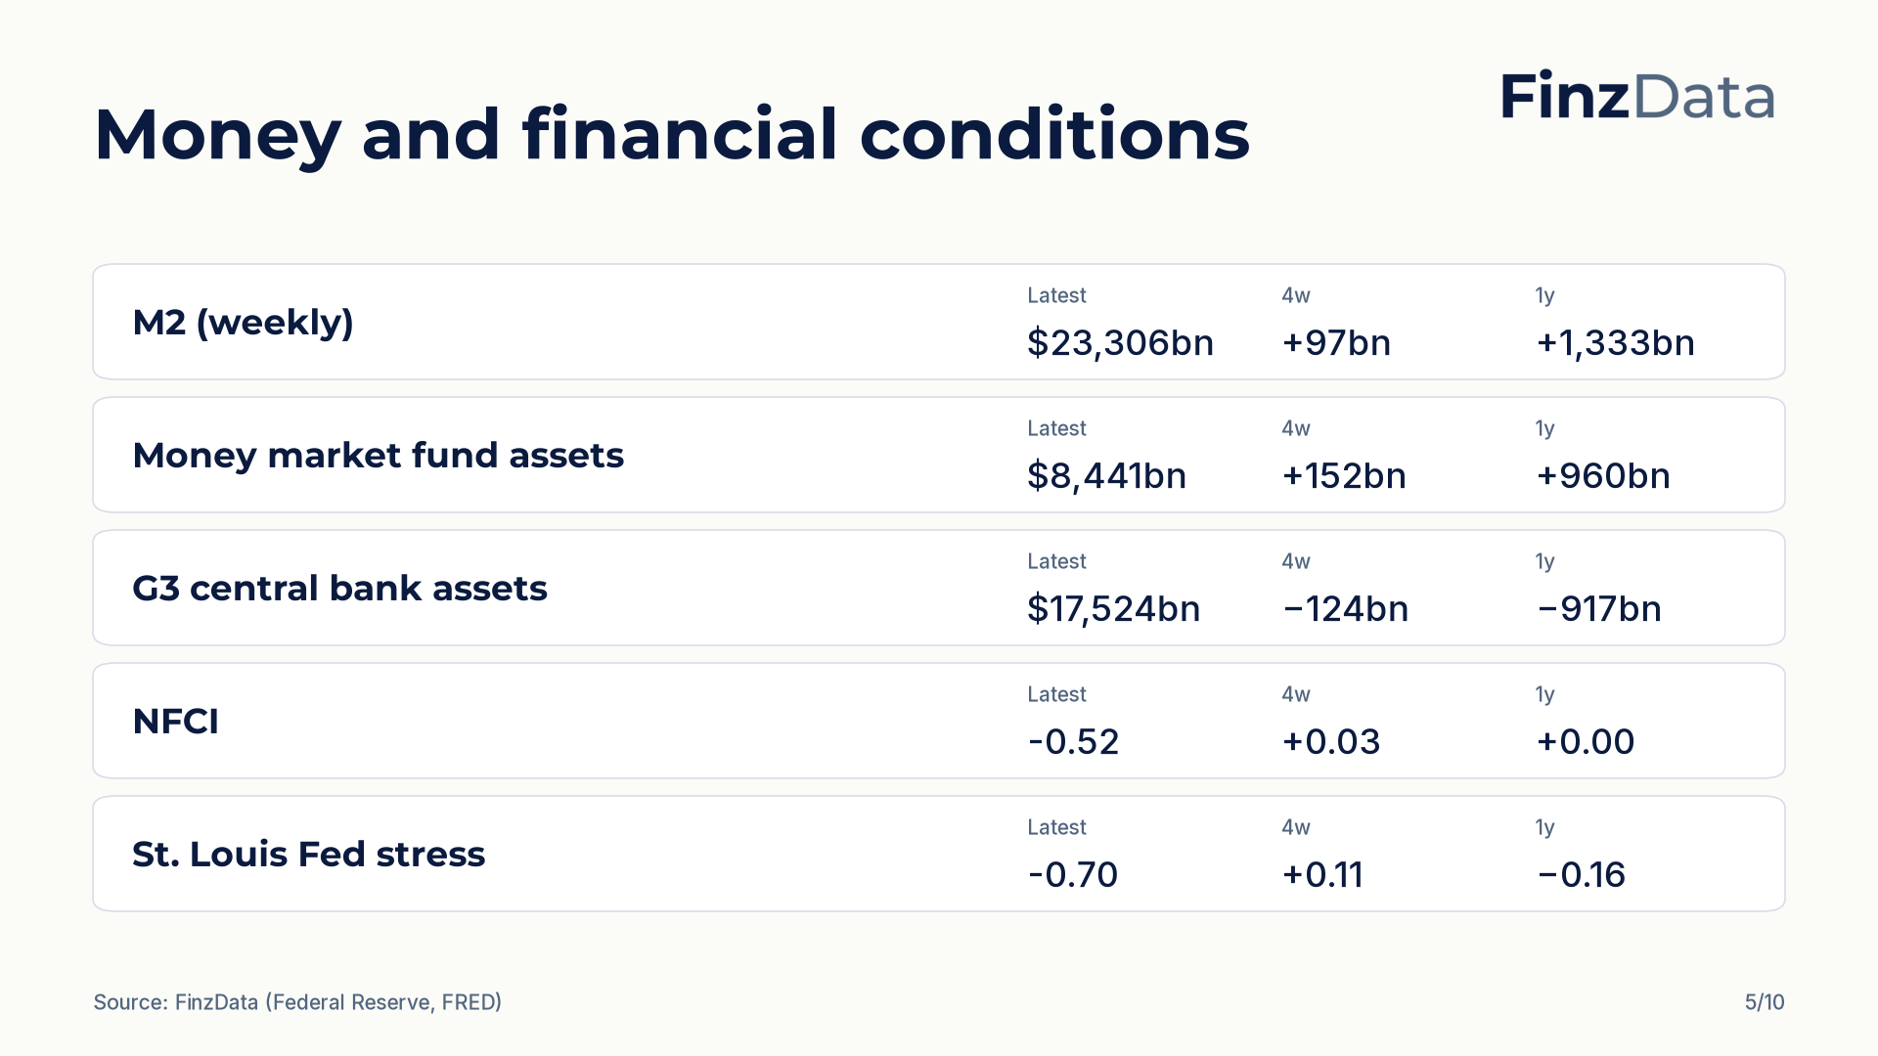
Notes:
Money and financial conditions snapshot. For example, M2 (weekly) stands at $23,306bn as of 2026-08-31.

Slide 6
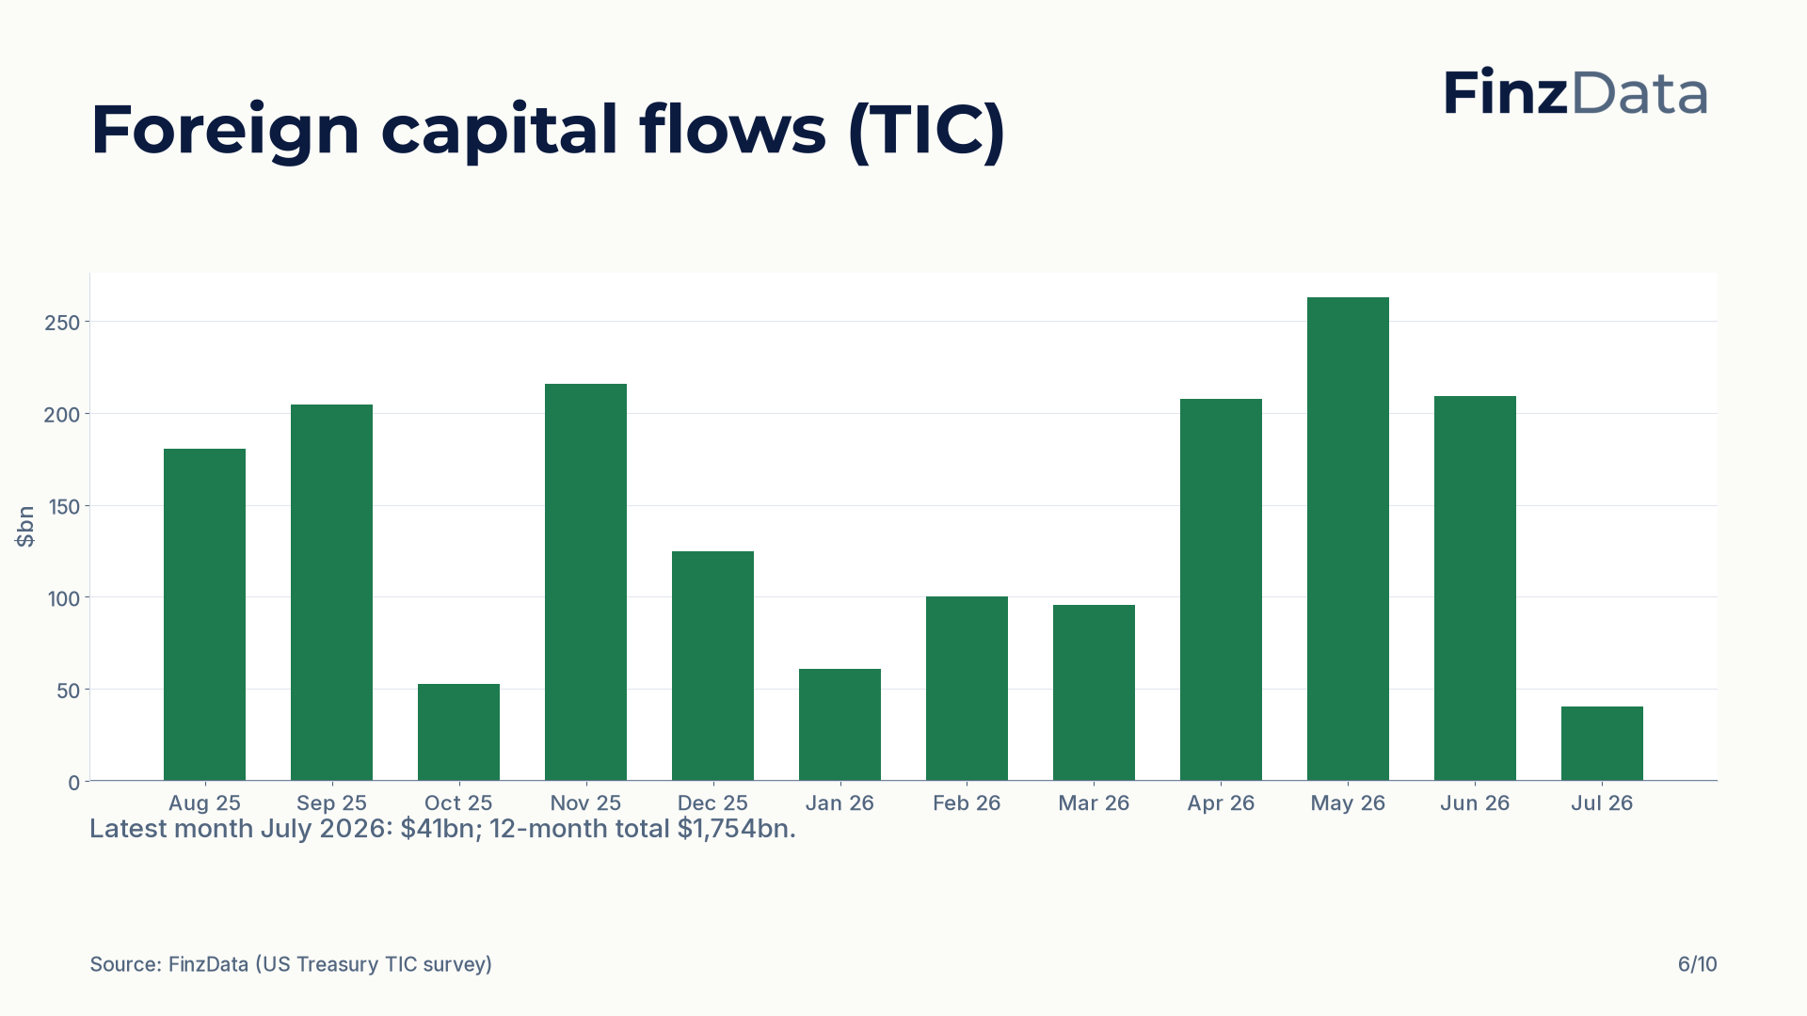
Notes:
Net foreign purchases of US long-term securities over the last 12 months. Latest month July 2026: $41bn; 12-month total $1,754bn.

Slide 7
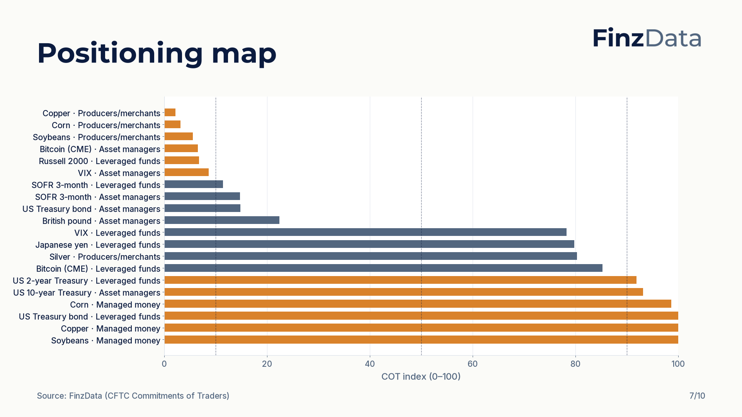
Notes:
COT index for every tracked market and trader group. Highest reading: US Treasury bond (Leveraged funds) at 100; lowest: Copper (Producers/merchants) at 2.

Slide 8
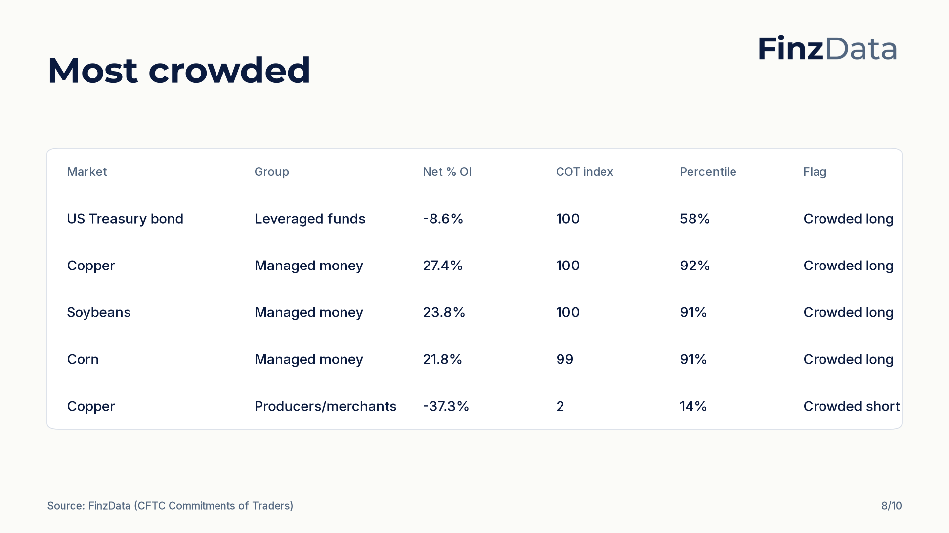
Notes:
Most crowded positioning by distance of the COT index from 50. Top of the list: US Treasury bond (Leveraged funds) with a COT index of 100 and net -8.6% of open interest.

Slide 9
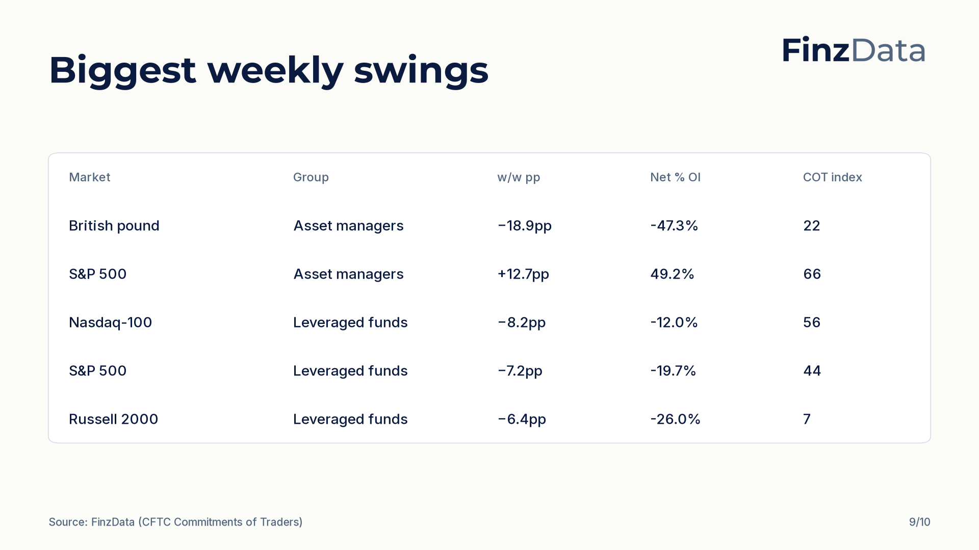
Notes:
Largest weekly swings in net percent of open interest. Biggest move: British pound (Asset managers) at −18.9pp to -47.3% of open interest.

Slide 10

Notes:
Closing slide. Every figure in this deck is available through the FinzData API; the full report is at finzdata.com/research/weekly/2026-09-26.

