Slide 1

Notes:
Cover slide for the FinzData Weekly issue dated October 10, 2026. The deck covers liquidity, capital flows and positioning for the week.

Slide 2
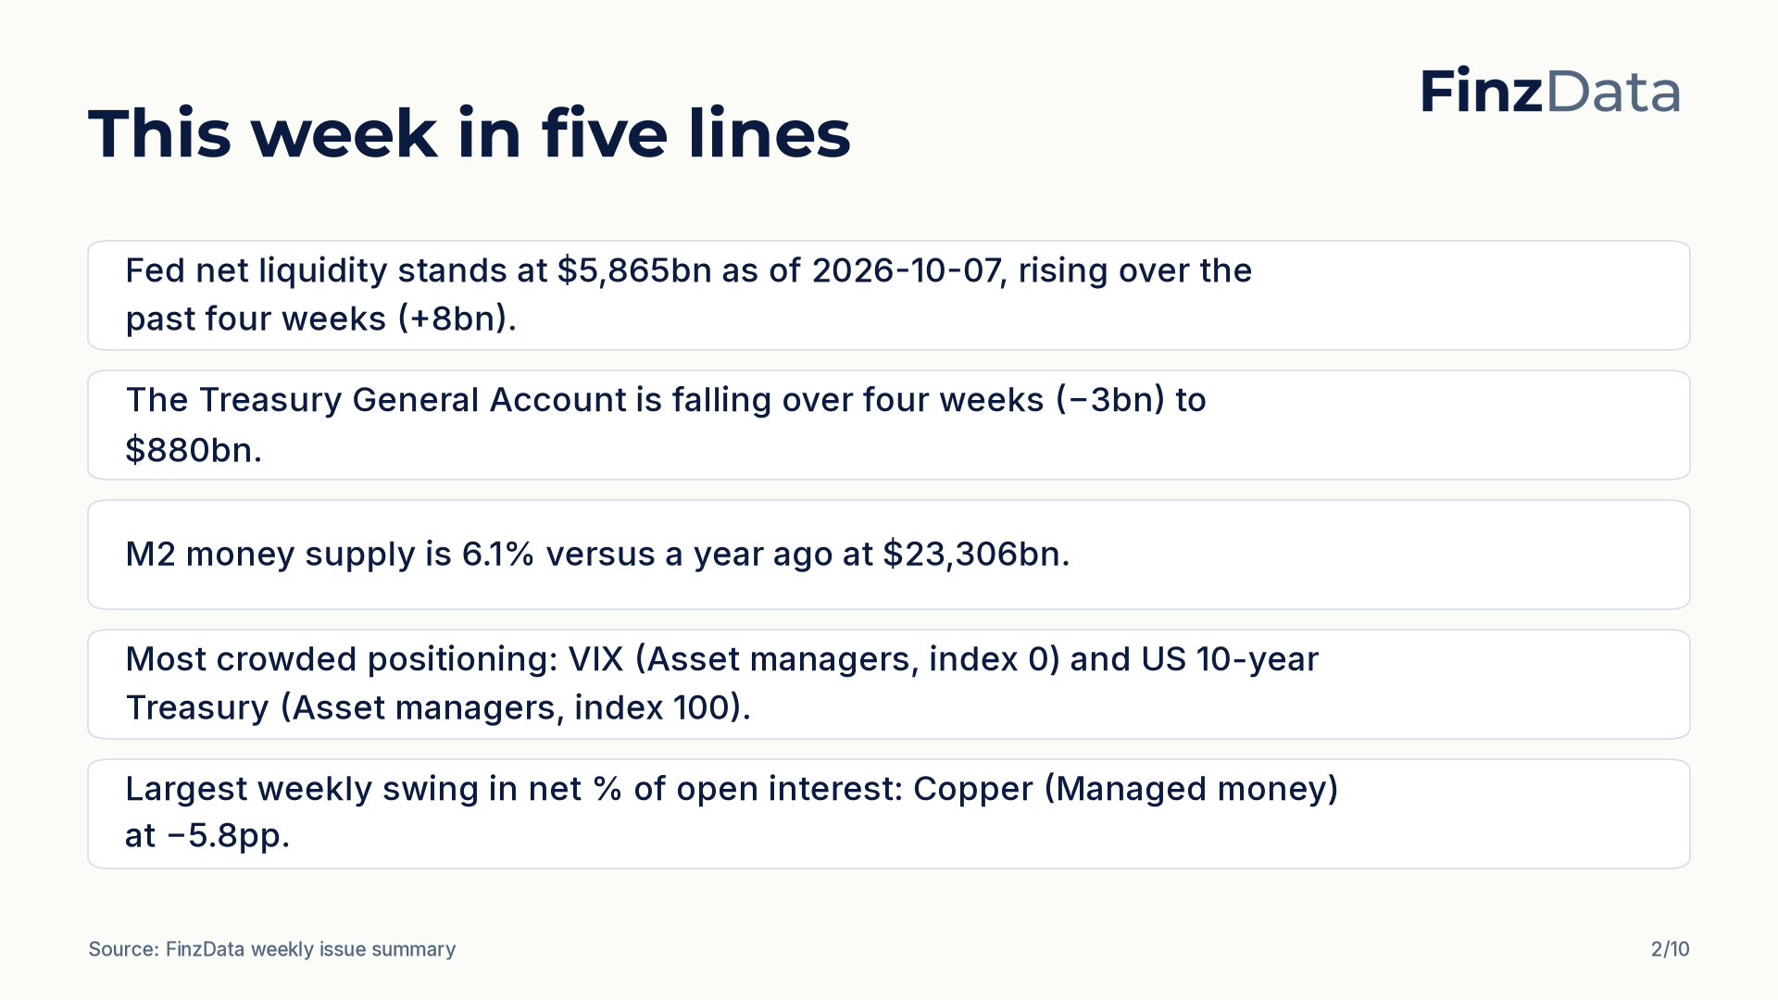
Notes:
Key takeaways from this week's issue: Fed net liquidity stands at $5,865bn as of 2026-10-07, rising over the past four weeks (+8bn). The Treasury General Account is falling over four weeks (−3bn) to $880bn.

Slide 3
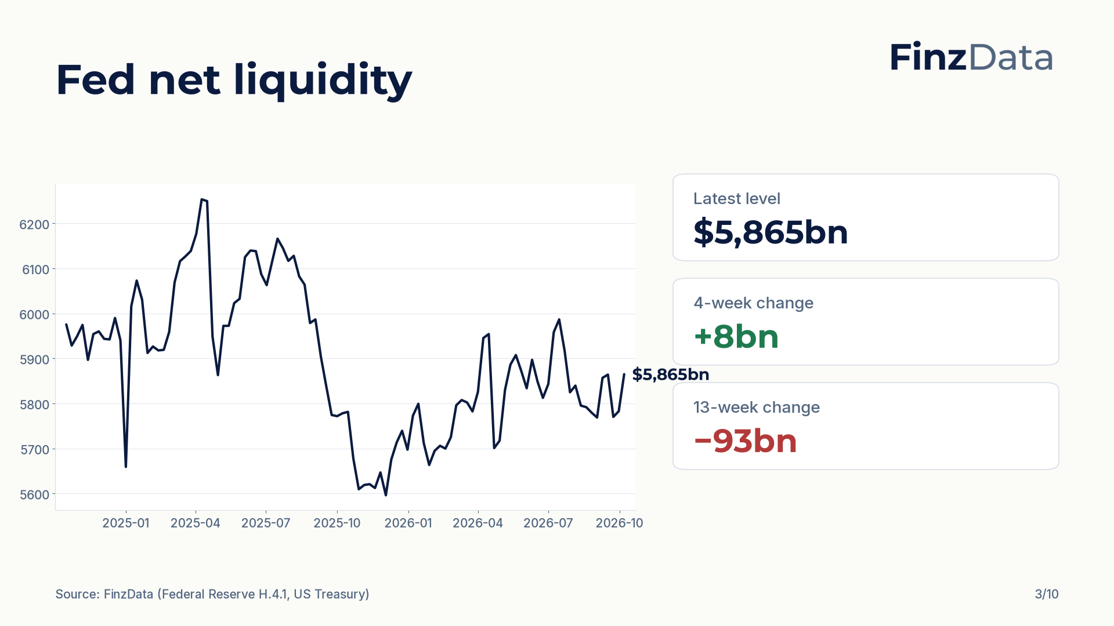
Notes:
Fed net liquidity stands at $5,865bn as of 2026-10-07. The four-week change is +8bn and the thirteen-week change is −93bn.

Slide 4
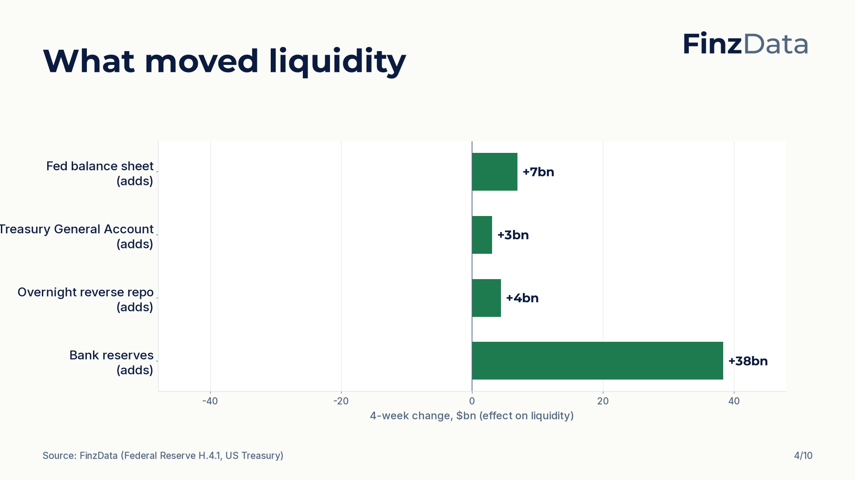
Notes:
Four-week changes in the components of net liquidity: Fed balance sheet +7bn; Treasury General Account +3bn; Overnight reverse repo +4bn; Bank reserves +38bn.

Slide 5
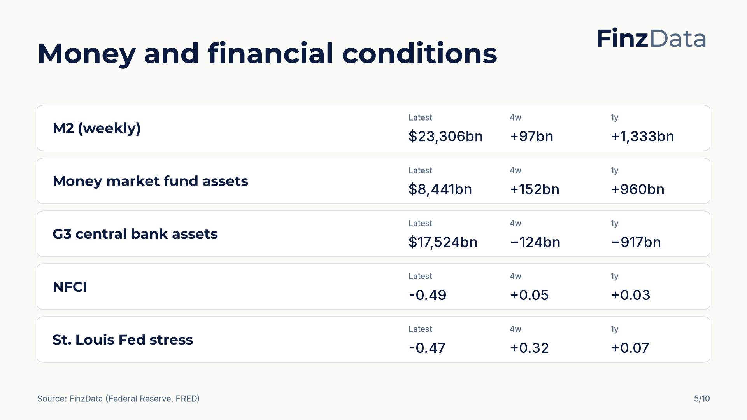
Notes:
Money and financial conditions snapshot. For example, M2 (weekly) stands at $23,306bn as of 2026-08-31.

Slide 6
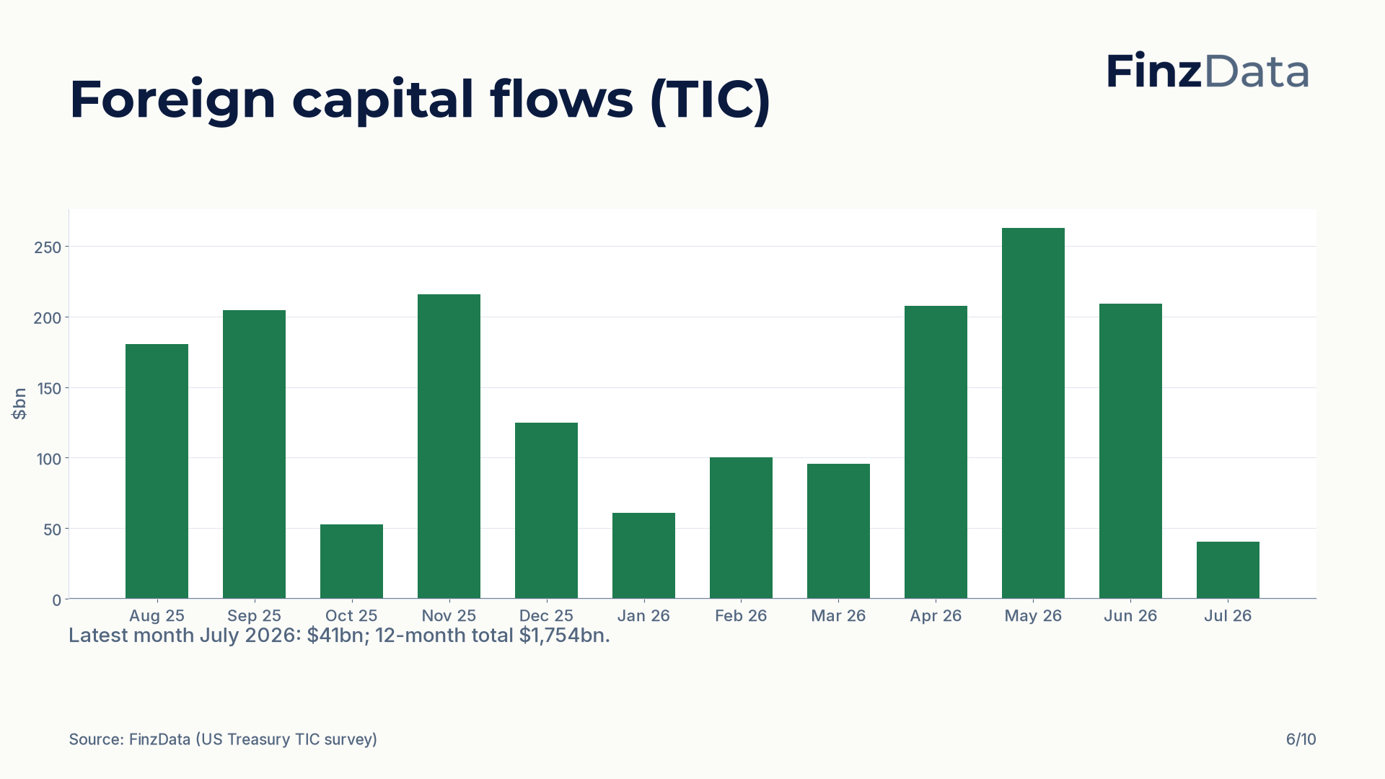
Notes:
Net foreign purchases of US long-term securities over the last 12 months. Latest month July 2026: $41bn; 12-month total $1,754bn.

Slide 7
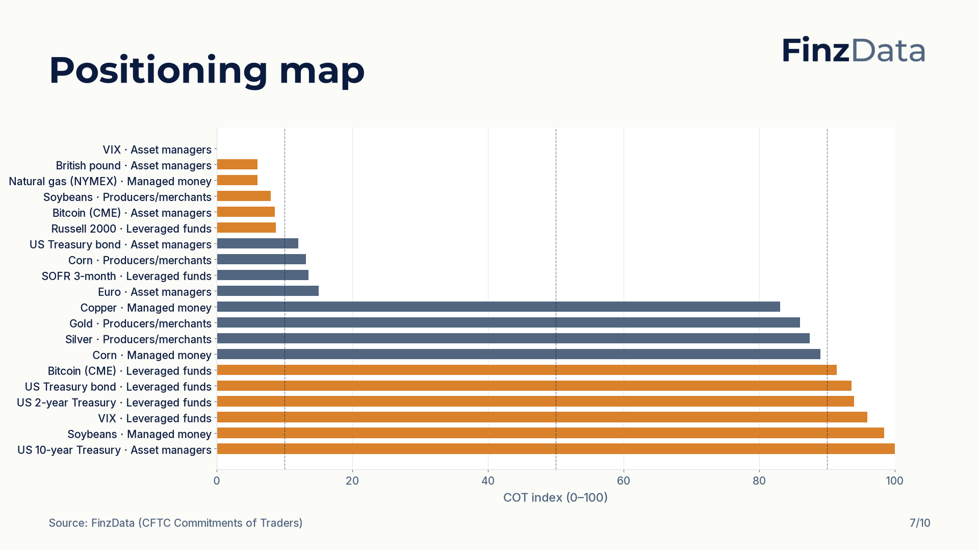
Notes:
COT index for every tracked market and trader group. Highest reading: US 10-year Treasury (Asset managers) at 100; lowest: VIX (Asset managers) at 0.

Slide 8
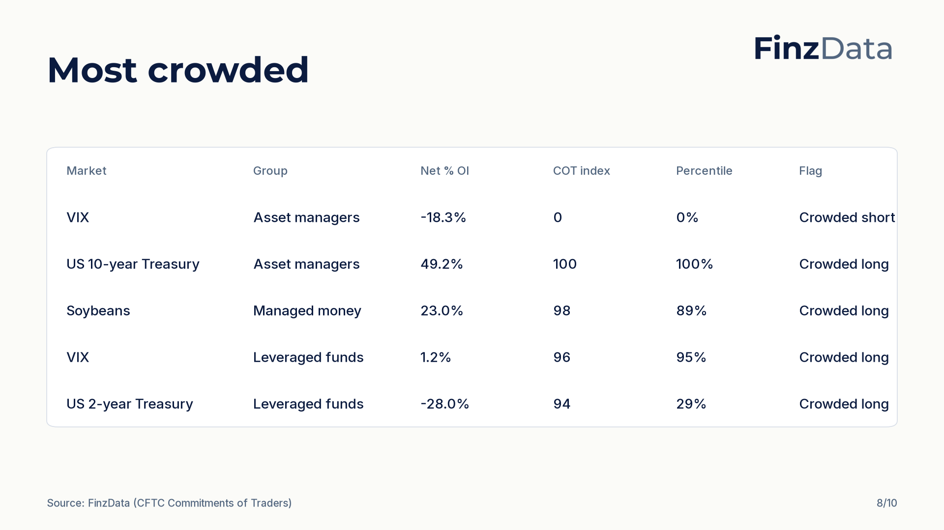
Notes:
Most crowded positioning by distance of the COT index from 50. Top of the list: VIX (Asset managers) with a COT index of 0 and net -18.3% of open interest.

Slide 9
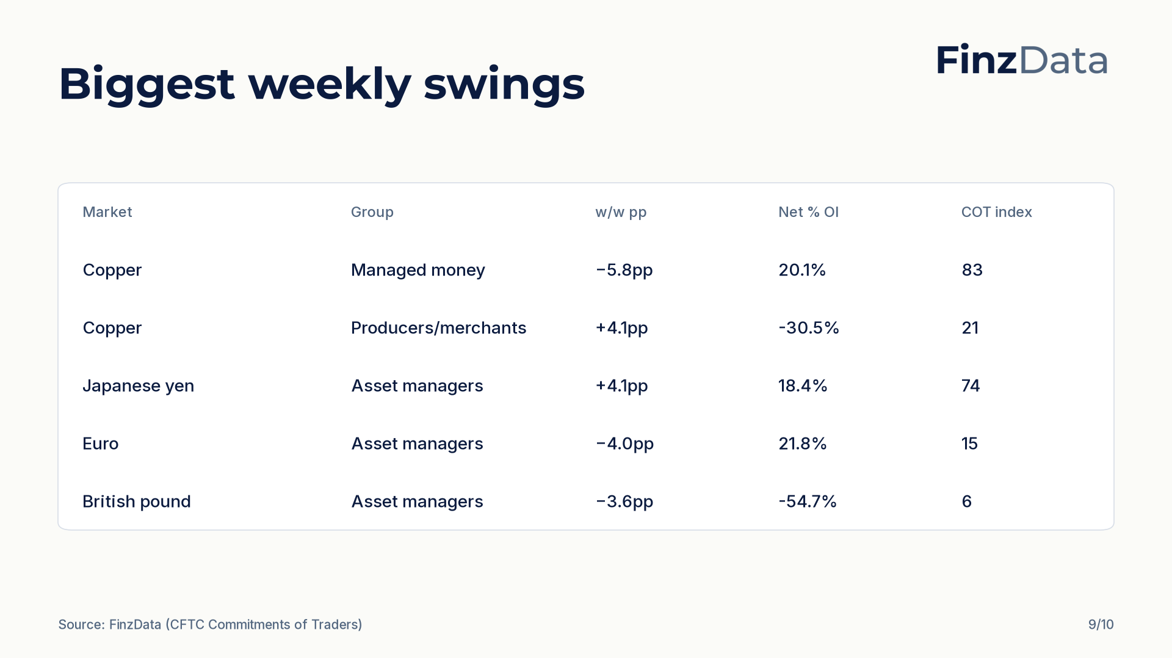
Notes:
Largest weekly swings in net percent of open interest. Biggest move: Copper (Managed money) at −5.8pp to 20.1% of open interest.

Slide 10

Notes:
Closing slide. Every figure in this deck is available through the FinzData API; the full report is at finzdata.com/research/weekly/2026-10-10.

