Slide 1

finzdata.com
Notes:
Cover slide for the FinzData Weekly issue dated November 6, 2026. The deck covers liquidity, capital flows and positioning for the week.
https://finzdata.com

Slide 2
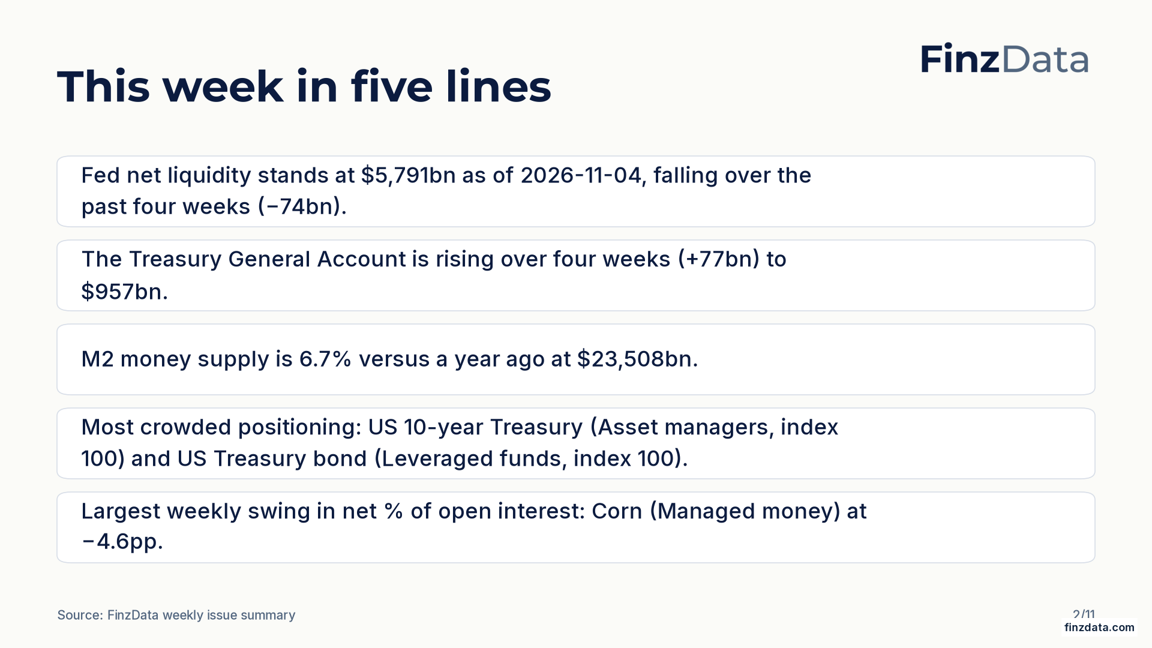
finzdata.com
Notes:
Key takeaways from this week's issue: Fed net liquidity stands at $5,791bn as of 2026-11-04, falling over the past four weeks (−74bn). The Treasury General Account is rising over four weeks (+77bn) to $957bn.
https://finzdata.com

Slide 3
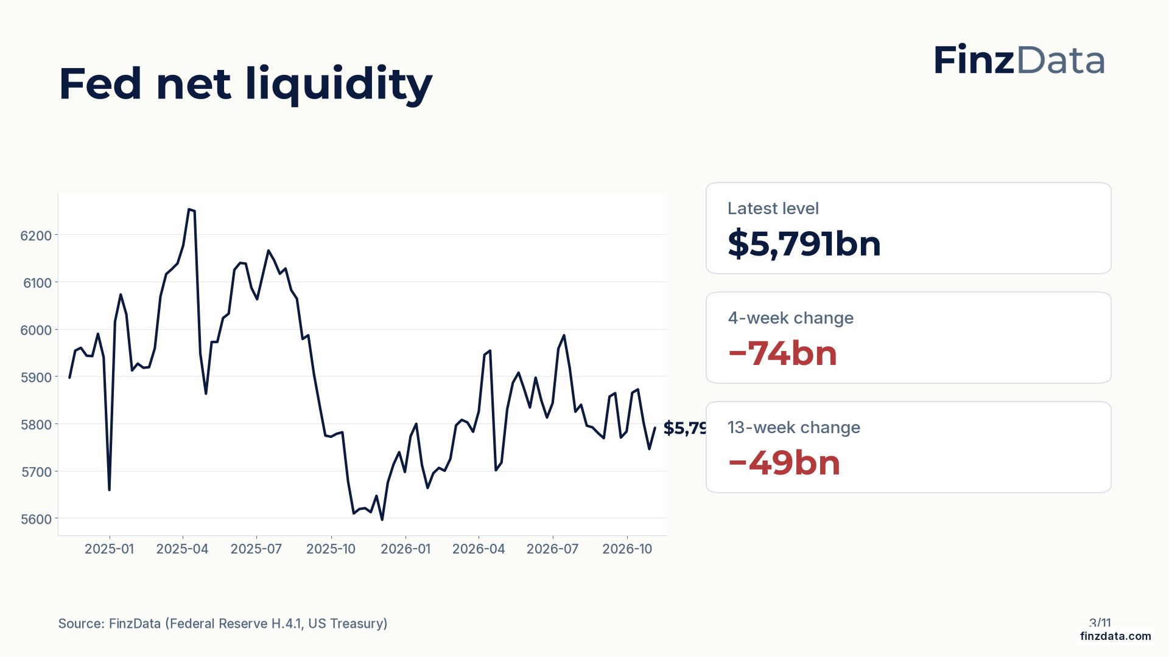
finzdata.com
Notes:
Fed net liquidity stands at $5,791bn as of 2026-11-04. The four-week change is −74bn and the thirteen-week change is −49bn.
https://finzdata.com

Slide 4
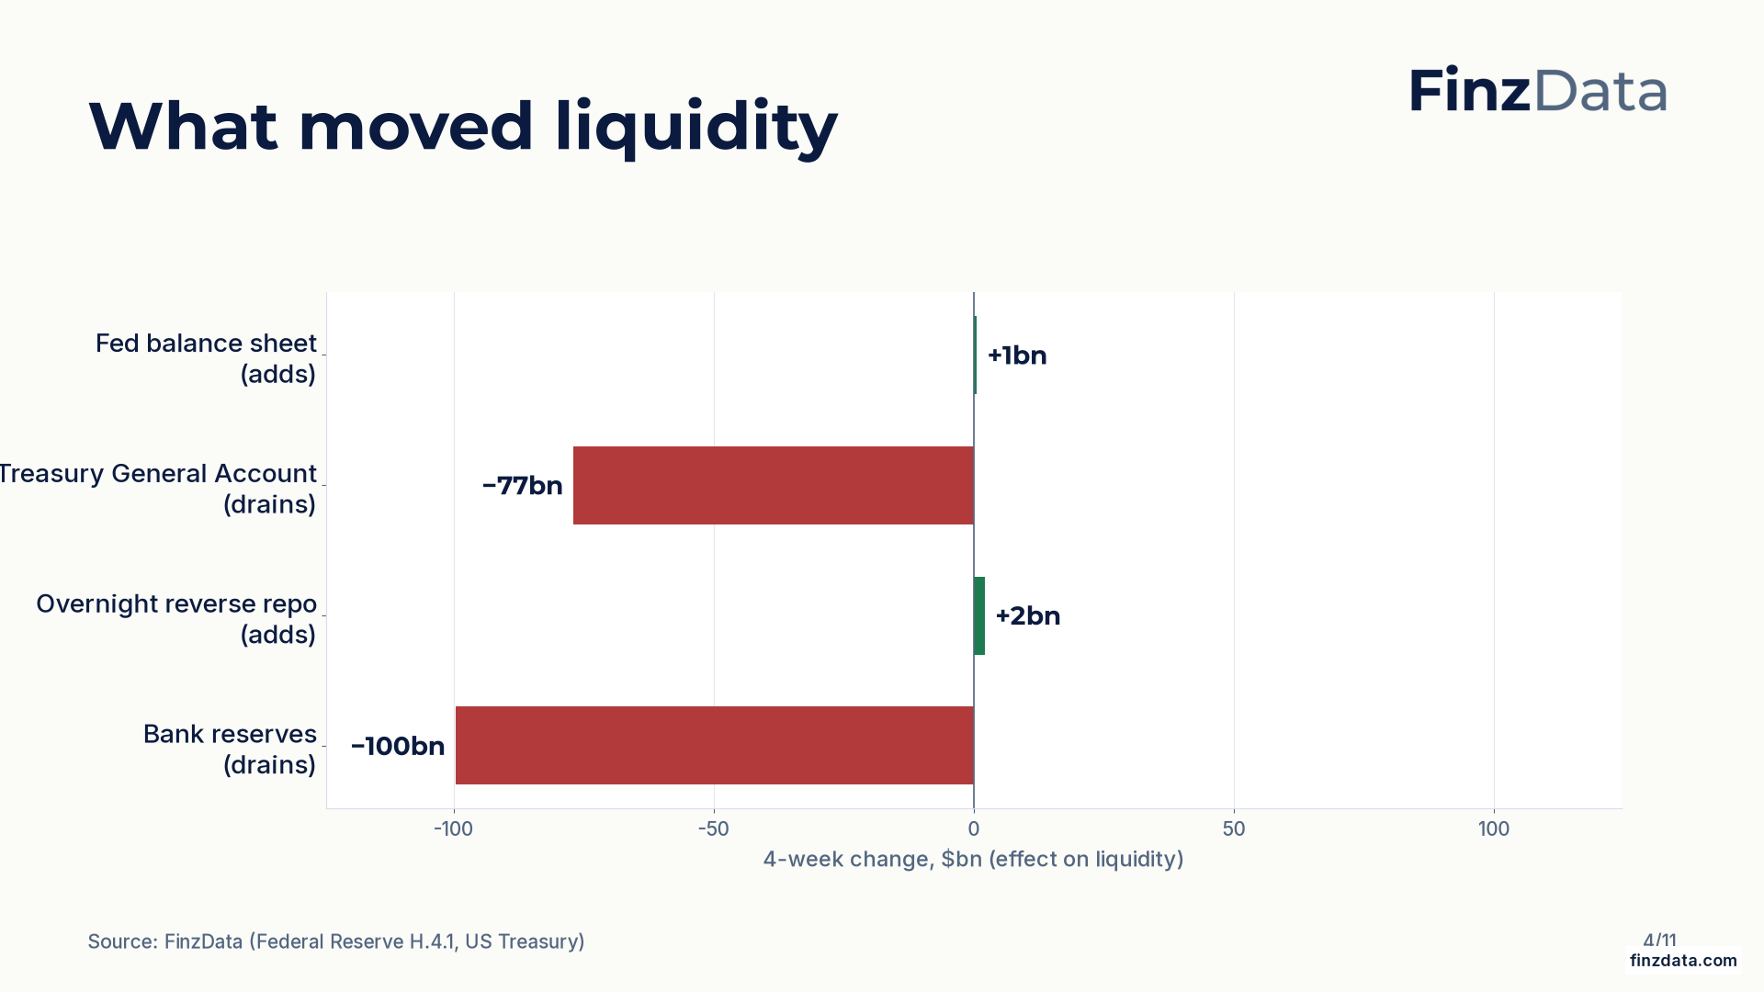
finzdata.com
Notes:
Four-week changes in the components of net liquidity: Fed balance sheet +1bn; Treasury General Account −77bn; Overnight reverse repo +2bn; Bank reserves −100bn.
https://finzdata.com

Slide 5
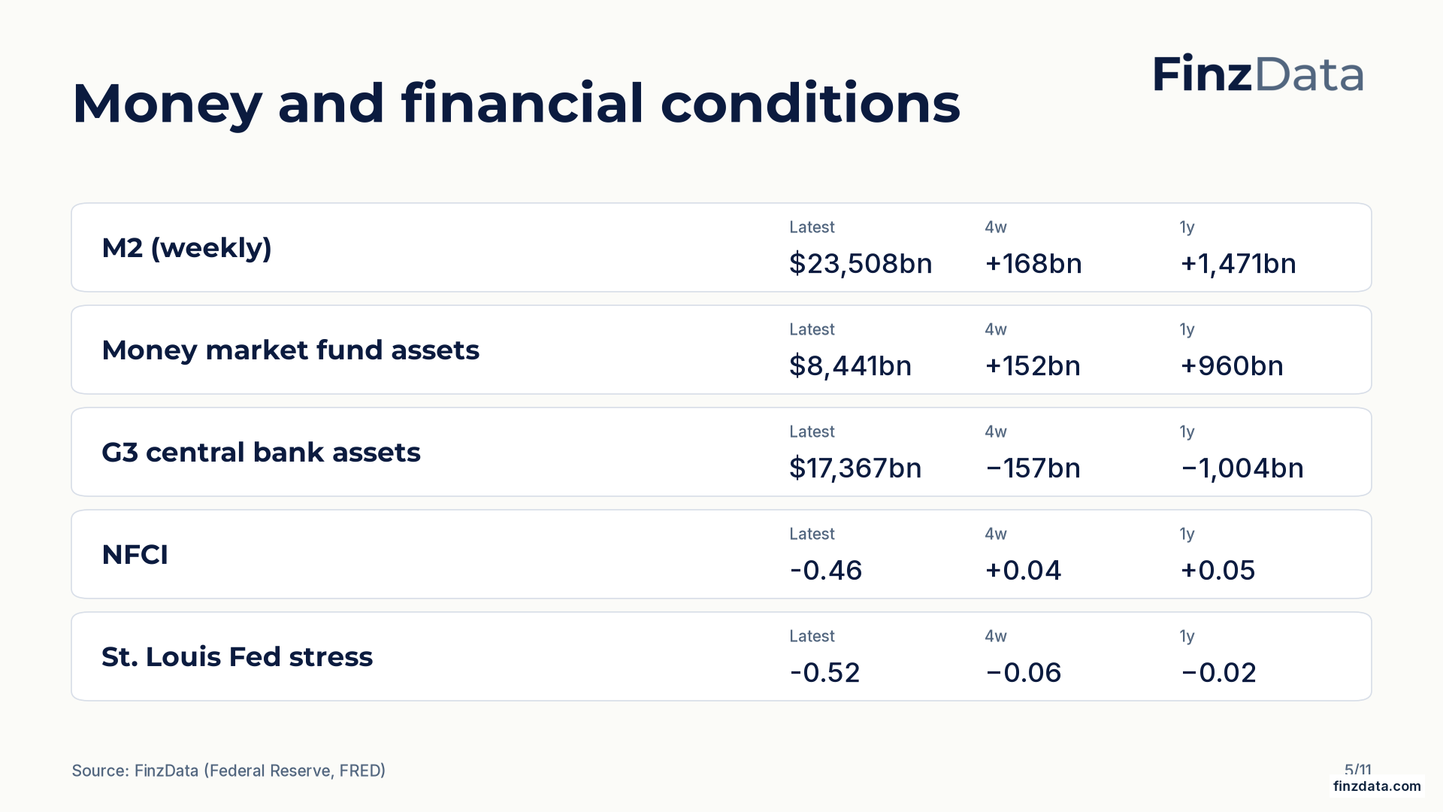
finzdata.com
Notes:
Money and financial conditions snapshot. For example, M2 (weekly) stands at $23,508bn as of 2026-10-05.
https://finzdata.com

Slide 6
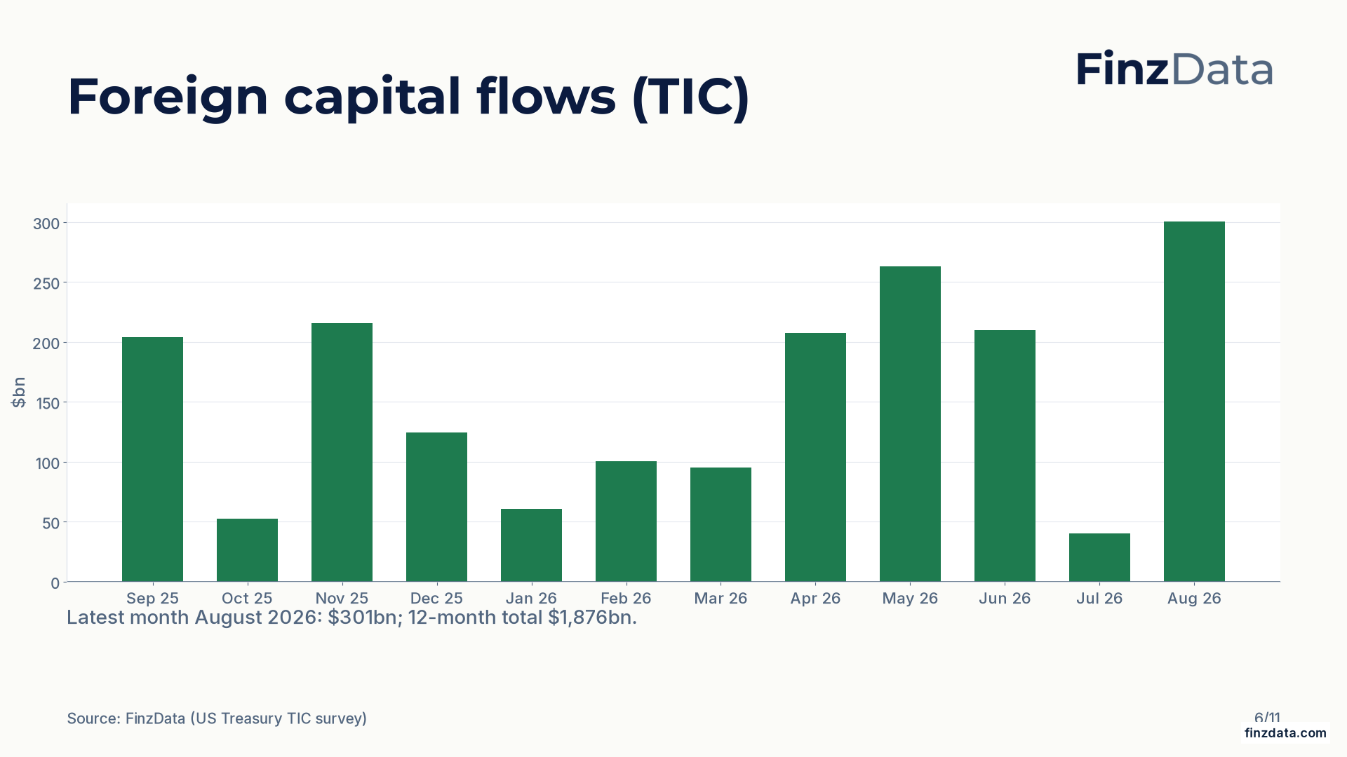
finzdata.com
Notes:
Net foreign purchases of US long-term securities over the last 12 months. Latest month August 2026: $301bn; 12-month total $1,876bn.
https://finzdata.com

Slide 7
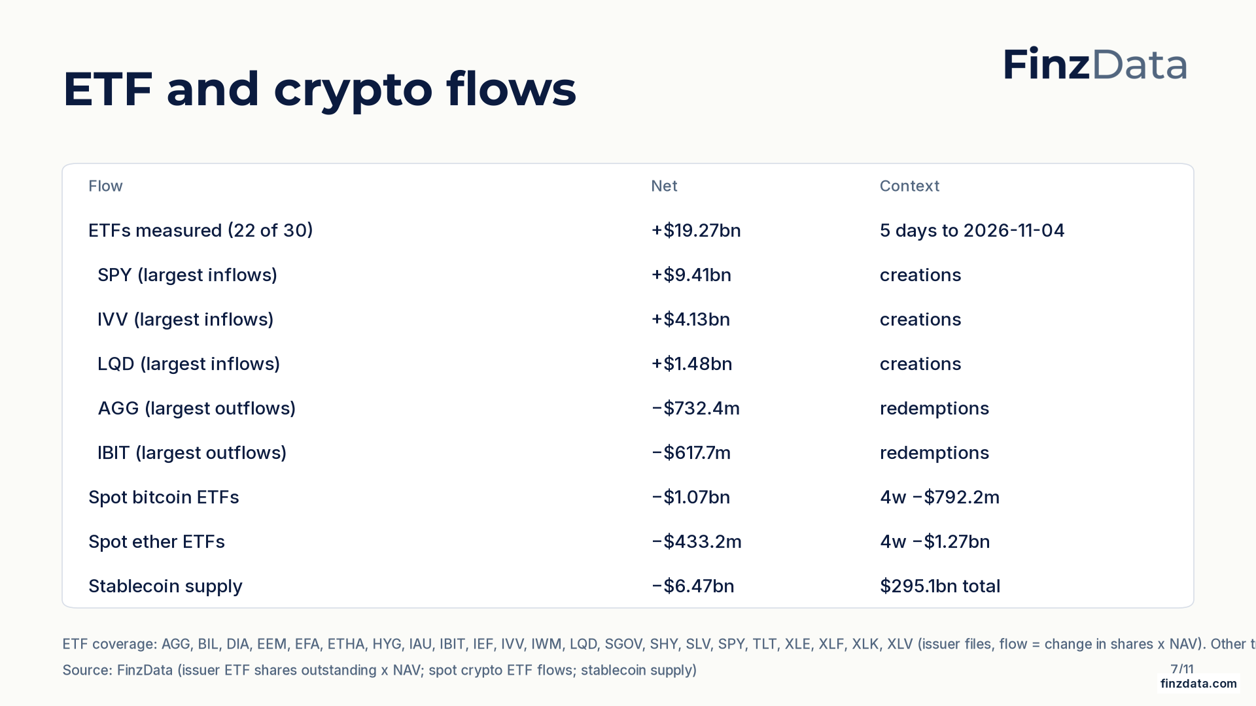
finzdata.com
Notes:
Net flow across the 22 of 30 tracked ETFs with issuer data this week: +$19.27bn. Not total US ETF flow. Spot bitcoin ETFs: −$1.07bn over the week, −$792.2m over four weeks. Spot ether ETFs: −$433.2m over the week, −$1.27bn over four weeks. USD stablecoin supply changed −$6.47bn over seven days to $295.1bn.
https://finzdata.com

Slide 8
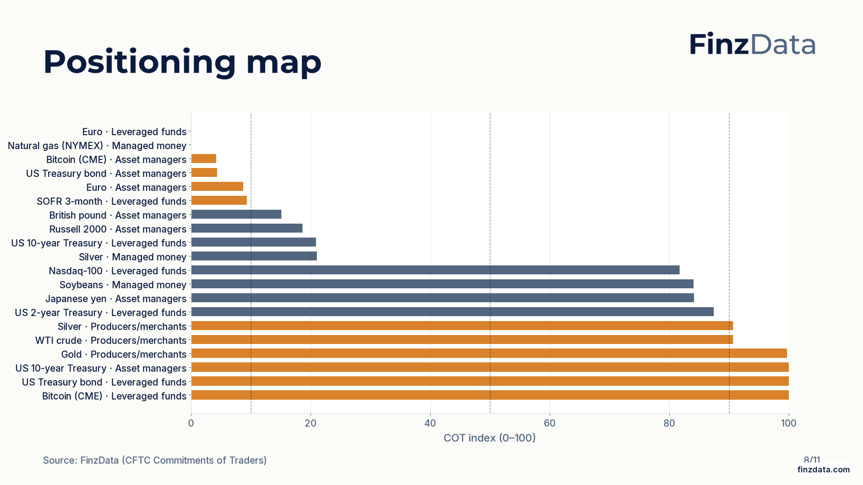
finzdata.com
Notes:
COT index for every tracked market and trader group. Highest reading: US 10-year Treasury (Asset managers) at 100; lowest: Euro (Leveraged funds) at 0.
https://finzdata.com

Slide 9
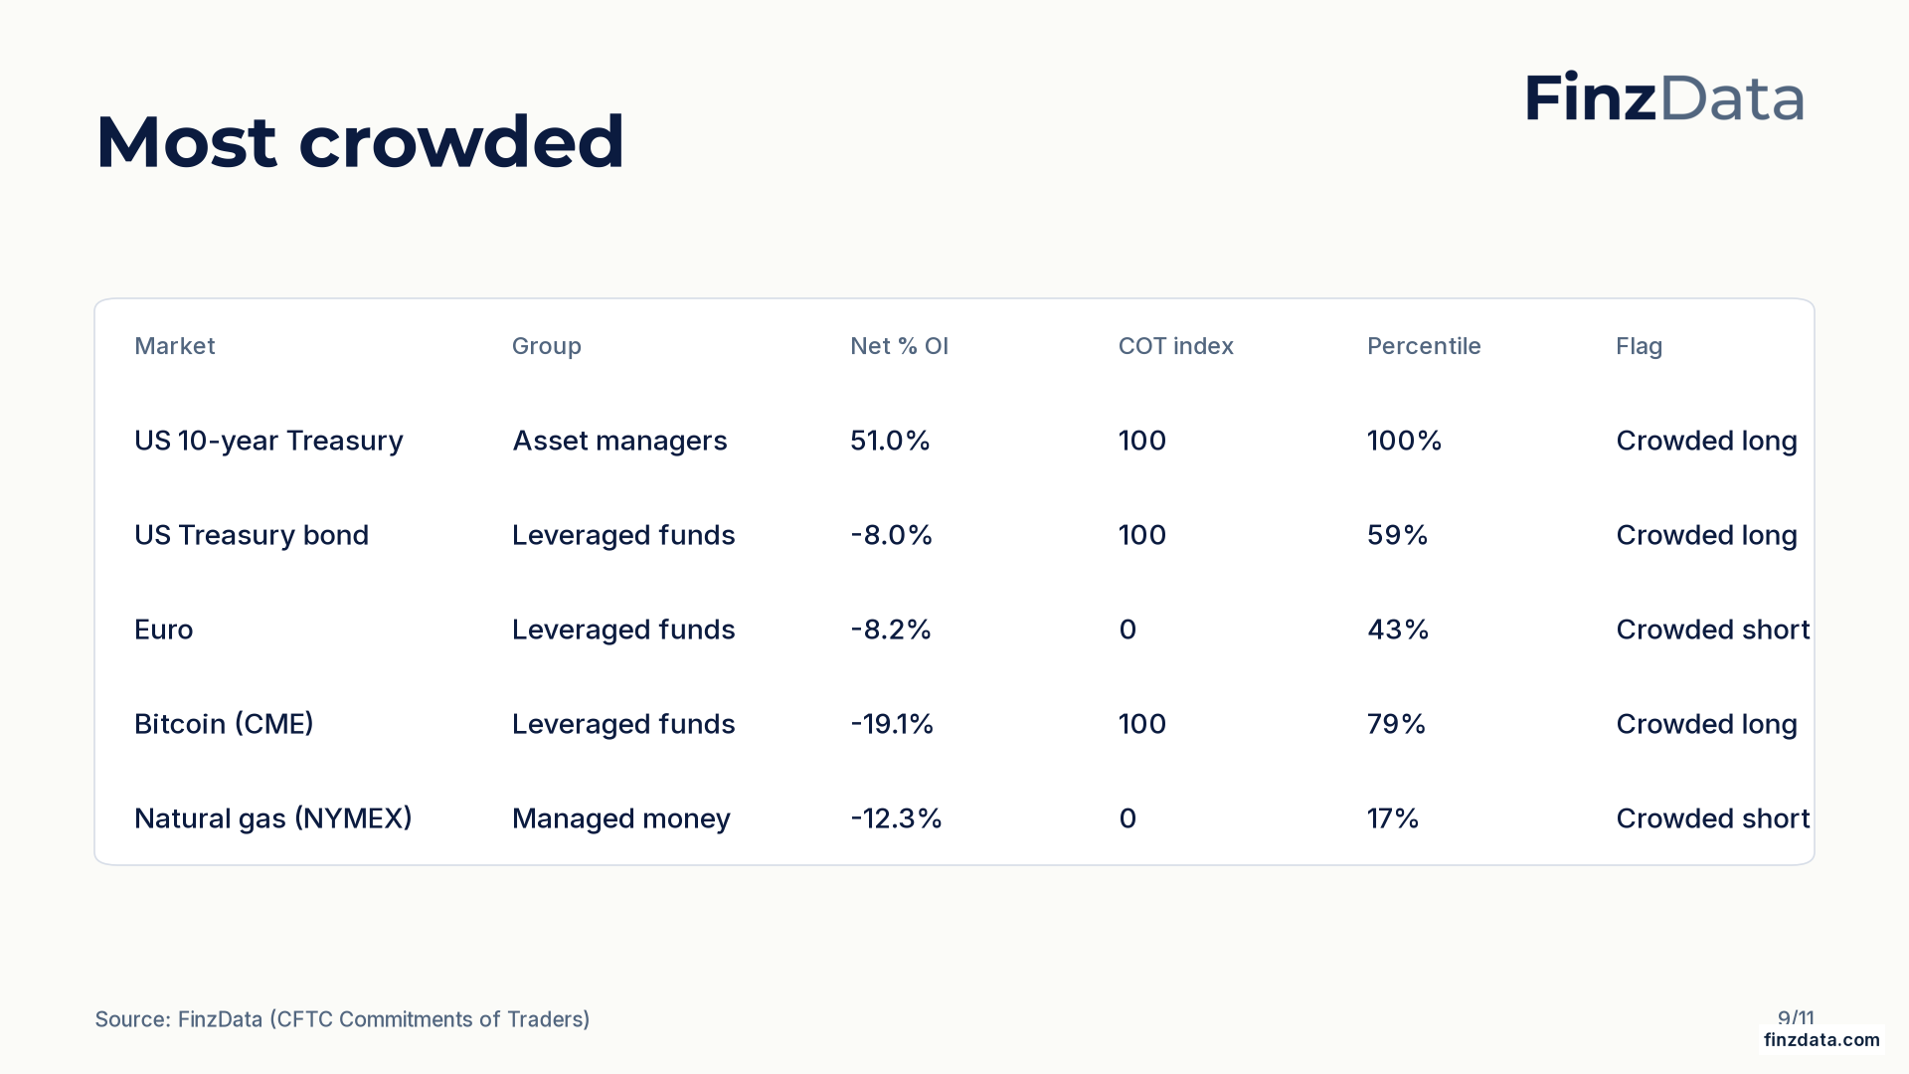
finzdata.com
Notes:
Most crowded positioning by distance of the COT index from 50. Top of the list: US 10-year Treasury (Asset managers) with a COT index of 100 and net 51.0% of open interest.
https://finzdata.com

Slide 10
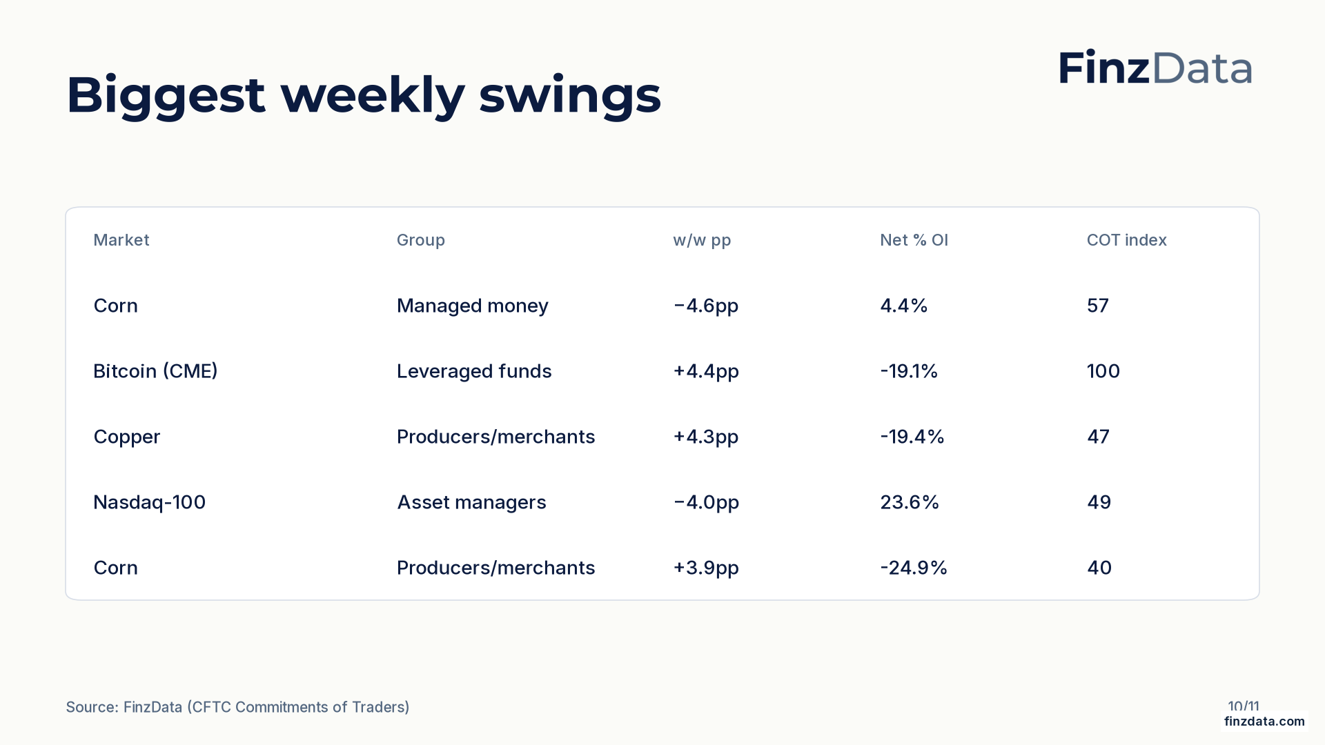
finzdata.com
Notes:
Largest weekly swings in net percent of open interest. Biggest move: Corn (Managed money) at −4.6pp to 4.4% of open interest.
https://finzdata.com

Slide 11
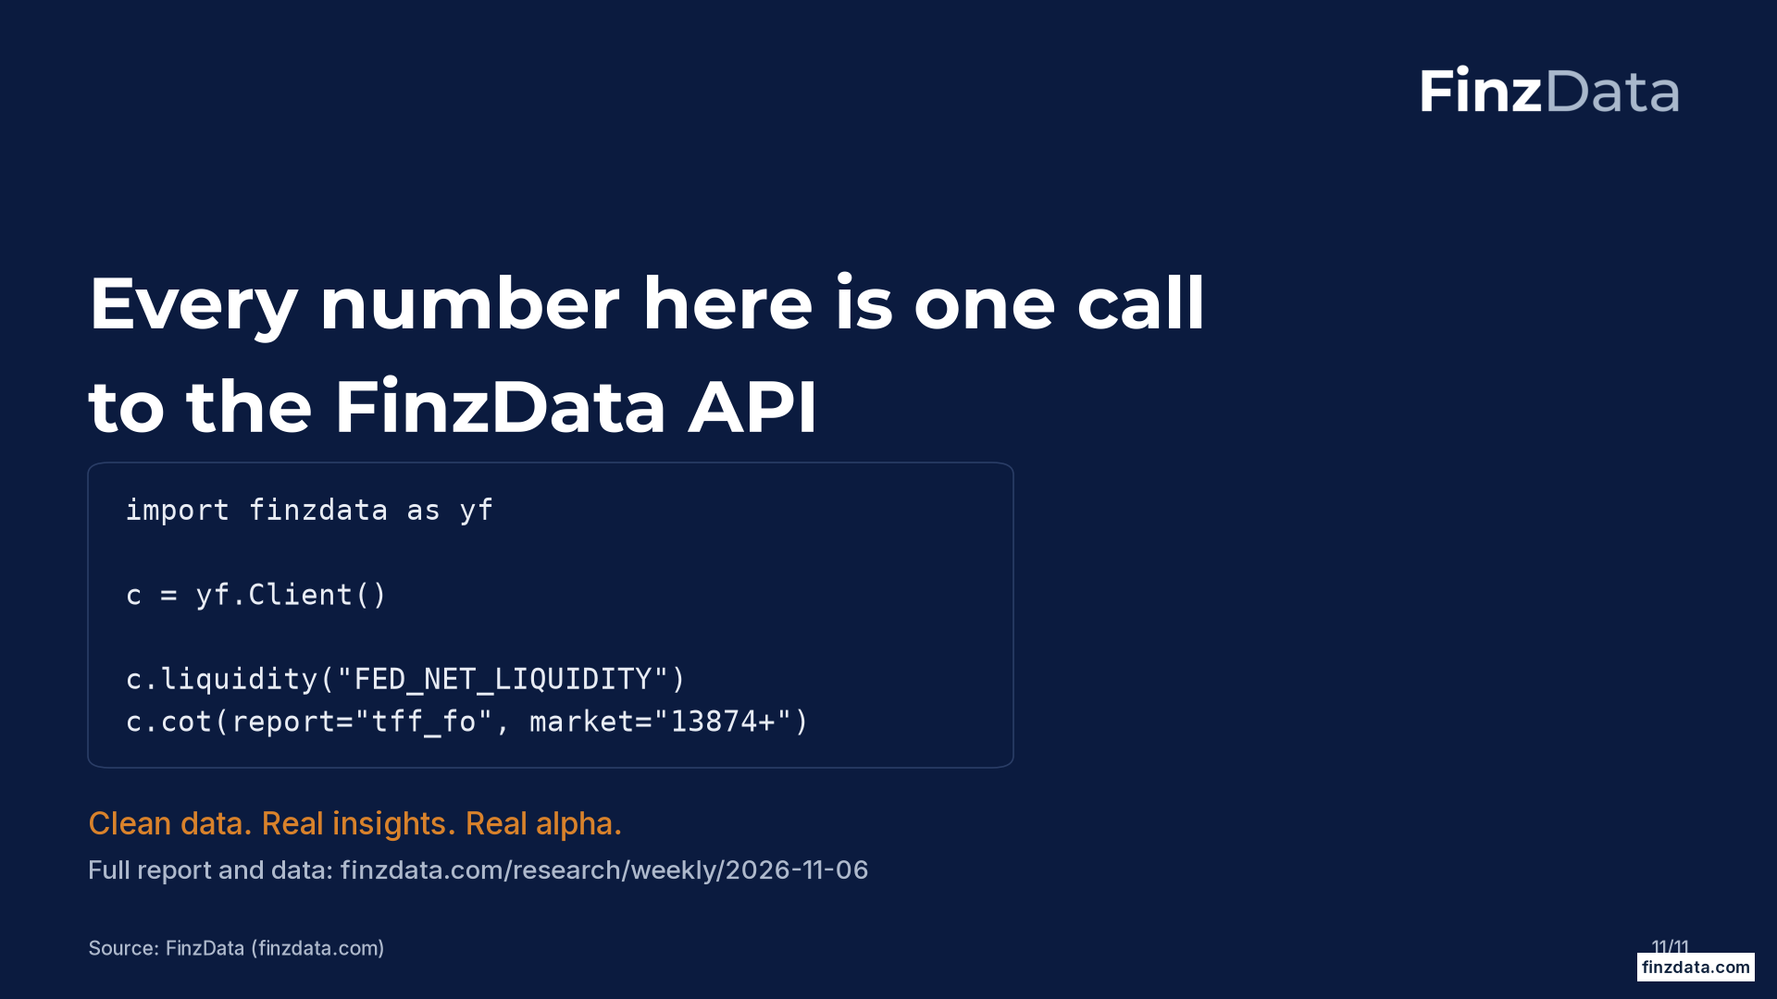
finzdata.com
Notes:
Closing slide. Every figure in this deck is available through the FinzData API; the full report is at finzdata.com/research/weekly/2026-11-06.
https://finzdata.com

